Slide 1


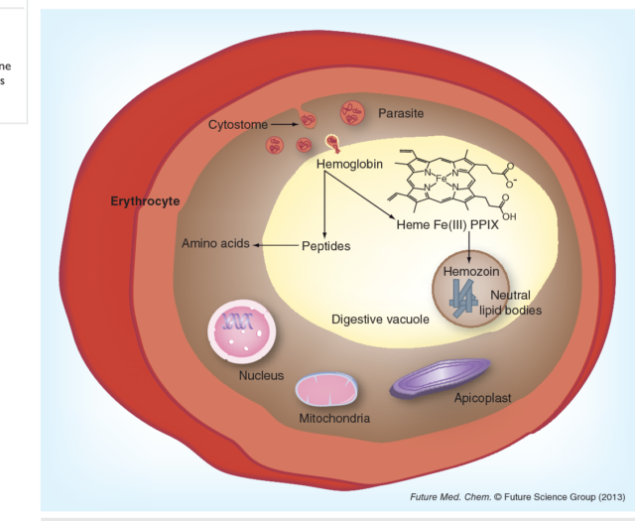
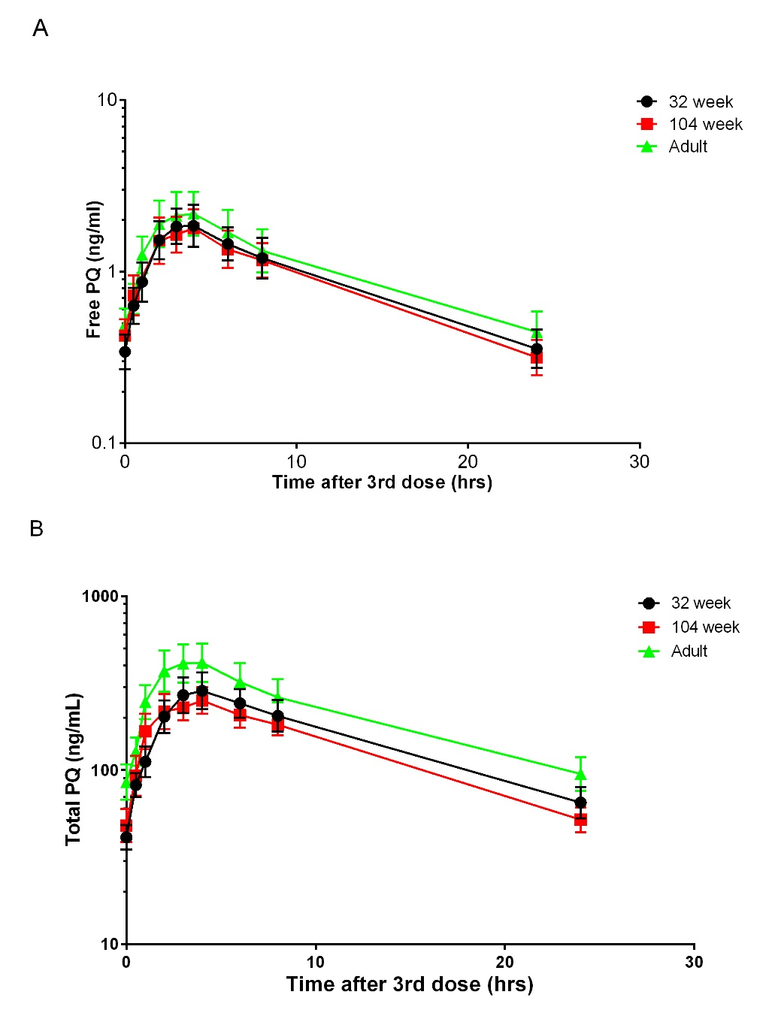
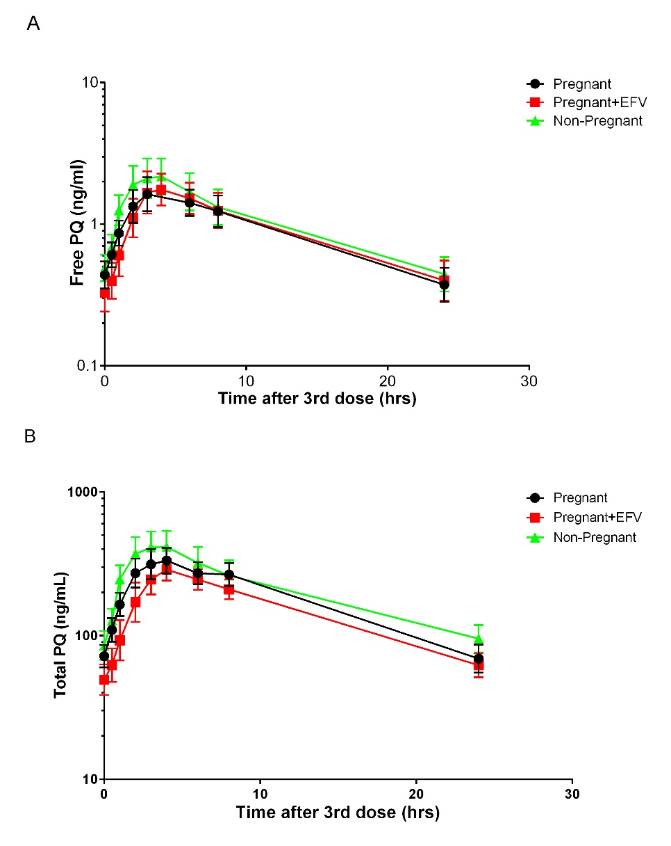
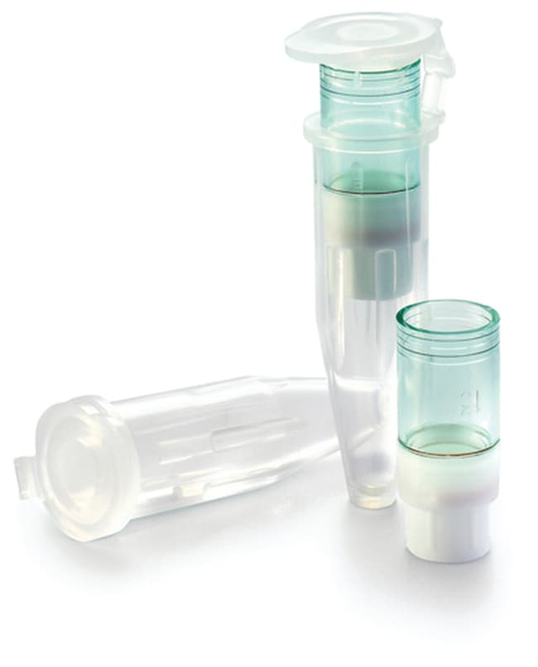
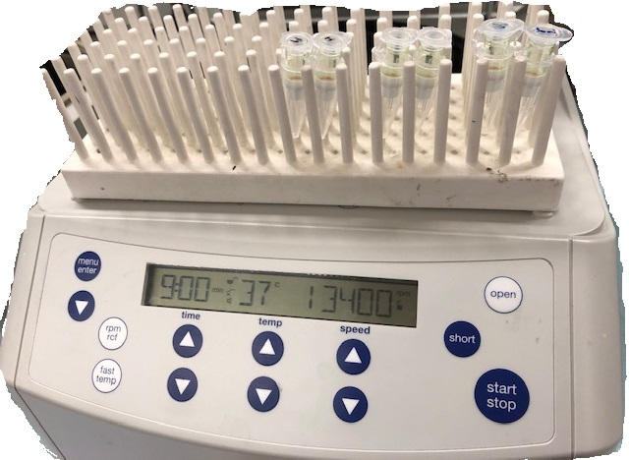
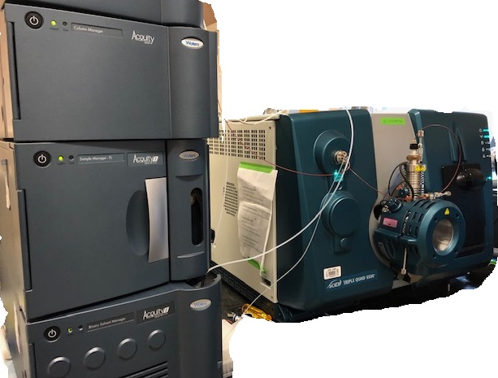
5496
Unbound piperaquine exposure in children and pregnant women receiving dihydroartemisinin-piperaquine as malaria chemoprevention
Usman Aslam-Mir¹, Howard Hong¹, Xay Pham¹, Richard Kajubi², Meghan E. Whalen¹, Norah Mwebaza², Erika Wallender¹, Grant Dorsey¹, Philip J. Rosenthal¹, Francesca T. Aweeka¹, Liusheng Huang¹
¹University of California, San Francisco, San Francisco, CA, United States, ²Infectious Diseases Research Collaboration, Kampala, Uganda
Contact: Liusheng Huang, Ph.D.
Dept. of Clin. Pharm. at UCSF
Tel: 415-502-2594
Email: Liusheng.huang@ucsf.edu
Introduction
Table 2. PK parameters of piperaquine in children receiving dihydroartemisinin-PPQ as chemoprevention
Dihydroartemisinin-piperaquine has been studied for malaria prevention due to the long elimination half-life of piperaquine (PPQ).
Only unbound PPQ transverses biological
membranes and exerts pharmacological effects
at active sites-- digestive vacuole (Yellow core in
Figure1). PPQ is protonated and trapped in the
acidic digestive vacuole
Mechanism of action: PPQ binds to heme Fe³⁺
in digestive vacuole to prevent hemozoin formation.
Young Children and pregnant women have
distinct physiological conditions that may alter
drug-protein binding.
We previously reported a reduced exposure of
PPQ (protein-bound and unbound) in children and
pregnant women, but unbound PPQ exposure
has not been studied.
 | Children
 | 32 weeks | 104 weeks | Adult |  | 104 wk/32 wk | 32 week/adults | 104 week/adults
PK parameters | GM; 95%CI (n = 32) | GM; 95%CI (n = 31) | GM; 95%CI (n = 30) |  | GMR (p value) | GMR (p value) | GMR (p value)
Total PPQ
Cmax, ng/mL | 345 (279, 427) | 309 (266, 359) | 497 (392, 630) |  | 0.896 (0.69) | 0.694 (0.0037) | 0.622 (0.0002)
Tmax*, hr | 4.03 (3.06, 6.01) | 4.02 (2.03, 6.05) | 3.06 (2.07, 4.03) |  | 0.998 (0.21) | 1.32 (0.0085) | 1.31 (0.41)
AUC_{0-24h}, hr·µg/mL | 3.88 (3.24, 4.64) | 3.45 (3.04, 3.91) | 5.47 (4.41, 6.79) |  | 0.889 (0.29) | 0.709 (0.0034) | 0.631 (<0.0001)
Unbound PPQ
Cmax, ng/mL | 2.35 (1.84, 3.01) | 2.28 (1.90, 2.74) | 2.97 (2.29, 3.85) |  | 0.970 (0.95) | 0.791 (0.13) | 0.768 (0.043)
Tmax*, hr | 3.03 (2.06, 4.42) | 3.05 (2.03, 4.1) | 3.08 (3.00, 4.07) |  | 1.01 (0.86) | 0.984 (0.83) | 0.990 (0.85)
AUC_{0-24h}, hr·ng/mL | 23.0 (18.5, 28.7) | 23.0 (19.5, 27.1) | 28.1 (21.7, 36.3) |  | 1.00 (0.978) | 0.819 (0.071) | 0.819 (0.041)
f_{u} (%)** | 0.658 (0.618, 0.701) | 0.718 (0.685, 0.753) | 0.520 (0.501,0.539) |  | 1.09 (0.0064) | 1.27 (<0.0001) | 1.38 (<0.0001)
AUCfree/total (%) | 0.594(0.514, 0.686) | 0.666 (0.594, 0.746) | 0.513 (0.469, 0.560) |  | 1.12 (0.22) | 1.16 (0.13) | 1.30 (0.001)
Plasma PPQ
Figure 1 Active sites of piperaquine
Source: DOI:10.4155/fmc.13.113
Table 3. PK parameters of piperaquine in pregnant women receiving dihydroartemisinin-PPQ as chemoprevention with or without concomitant EFV-based ART
Method
 | Pregnant alone (P) | Preg+EFV | Non-pregnant (NP) |  | P/NP | Preg+EFV/P | Preg+EFV/NP
PK parameters | GM; 90%CI (n=31) | GM; 90%CI (n=27) | GM; 90%CI (n=30) |  | GMR (p value) | GMR (p value) | GMR (p value)
Total PPQ
Cmax, ng/mL | 404 (332, 491) | 333 (277, 400) | 497 (392, 630) |  | 0.813 (0.13) | 0.824 (0.067) | 0.670 (<0.01)
Tmax*, hr | 3.08 (3.00, 4.03) | 4.00 (2.03, 5.98) | 3.06 (2.07, 4.03) |  | 1.01 (0.71) | 1.30 (0.78) | 1.31 (0.65)
AUC0-24h, hr·µg/mL | 4.58 (3.85, 5.44) | 3.77 (3.25, 4.38) | 5.49 (4.42, 6.81) |  | 0.834 (0.11) | 0.823 (0.019) | 0.687 (<0.01)
Unbound PPQ
Cmax, ng/mL | 2.41 (1.83, 3.19) | 2.40 (1.88, 3.07) | 2.97 (2.29, 3.85) |  | 0.811 (0.20) | 1.00 (0.95) | 0.808 (0.14)
Tmax*, hr | 3.98 (3.02, 4.03) | 4.00 (2.98, 4.07) | 3.08 (3.00, 4.07) |  | 1.29 (0.71) | 1.01 (0.81) | 1.30 (0.72)
AUC0-24, hr·ng/mL | 23.6 (18.8, 29.5) | 24.2 (19.1, 30.5) | 28.2 (21.8, 36.5) |  | 0.837 (0.12) | 0.975 (0.87) | 0.858 (0.13)
fu (%)** | 0.533 (0.510, 0.557) | 0.641 (0.602, 0.682) | 0.520 (0.501,0.539) |  | 1.03 (0.66) | 1.20 (<0.01) | 1.23 (<0.01)
AUCfree/total (%) | 0.515 (0.464, 0.570) | 0.640 (0.543, 0.754) | 0.514(0.471, 0.562) |  | 1.00(0.90) | 1.24 (<0.01) | 1.25 (<0.01)
Clinical Trial design: The study was a part of a large study carried out between December 2014 and May 2017 in Tororo, Uganda. Enrollment for pharmacokinetic (PK) study is shown in Figure 2.
300 HIV uninfected Pregnant women
Childhood maturation
200 HIV infected Pregnant women
EFV-based ART
31 intensive PK
at 28 wk gestation
32 intensive PK
Children at 32 wk
27 intensive PK
at 28 wk gestation
- 4
+ 3
- 1
30 intensive PK
Postpartum at 34-54wk
31 intensive PK
Children at 104 wk
Figure 2. Study population
Drug administration and PK sampling: Dihydroartemisinin-piperaquine was given once daily for 3 days at standard doses every 4 weeks or 8 weeks for malaria prevention. PK samples were collected post last dose at 0, 0.5, 1, 2, 3, 4, 6, 8, and 24 hr for unbound and total PQ determination in venous plasma.
Determination of unbound PPQ: unbound PPQ was separated from plasma with Microcon Ultracel centrifugal filter devices (NMWL 10k), mixed with IS (PPQ-d₆) and injected into UPLC-MS/MS system (Figure 3). The calibration range was 20 – 5000 pg/mL.
1. 5% BAK wash
2. 100 µL plasma
Filtrate + IS (4:1)
Figure 3. unbound PPQ quantitation
Figure 4. Mean plasma concentration versus time profile for PPQ in children aged 32 weeks (black line), the same children aged 104 weeks (red line), and the adults (green line). Error bars represent 95% confidence interval. Top, unbound PQ; bottom, total PQ
Figure 5. Mean plasma concentration versus time profile for PPQ in HIV-infected pregnant women with concomitant EFV-based ART (red line), HIV-uninfected pregnant women (black line), and postpartum women (green line). Error bars represent 95% confidence interval. Top, unbound PPQ; bottom, total PPQ
PK data analysis: Noncompartmental analysis was performed with Phoenix WinNonlin version 8.3.1 (Certara, Princeton, NJ) using the linear up- log down trapezoidal rule. PK parameters C_{max} and AUC_{0-24h} were calculated for both total and unbund PPQ for comparison. Fraction of unbound PPQ (f_{u}) was calculated with each paired concentration (PPQ_{unbound}/PPQ_{total}). Stata version SE14.1 was used for the statistical analyses.
P<0.0001
+38%
P<0.0001
+27%
Conclusions
Results
P<0.0001
+23%
1. Increased fraction of unbound PPQ in children partially compensated for reduction of total PPQ exposure.
2. Increased fraction of unbound PPQ in the context of efavirenz partially compensated for reduction of total PPQ exposure. Data suggest binding site replacement drug-drug interaction.
3. Dose adjustment only based on total PPQ exposure may not be accurate
HIV⁺ women were older than HIV⁻ pregnant women (p<0.01) but their weights were similar, so the age difference is not expected to impact on drug-binding proteins. (Table 1). PK data for children are shown in Table 2 and Figure 4. PK data for pregnant women are shown in Table 3 and Figure 5. The f_{u} is shown in Figure 6.
+3%
References
Table 1. Demographic data of study participants
1. Huang et al. J Chromatogr Open. 2022; 2: 100042.
2. Kajubi et al. Clin Pharmacol Ther. 2017; 102(3): 520-528.
3. Whalen et al. Clin Pharmacol Ther. 2019;106(6):1310-18
4. Hong et al. Antimicrob Agents Chemother. 2023, 67(4): e0142722.
 | Children |  | Pregnant women at 28 wk gestation |  | Adults
 | 32 wk (n=32) | 104 wk (n=31) | HIV⁻ (n=31) | HIV⁺ (EFV, n=27) | n=30
Age (yr) | 0.61 | 2 | 23 (18, 31) | 30 (18, 43)* | 24 (19, 32)
Weight (kg) | 7.53 (6.01, 9.03) | 10.6 (8.37, 12.9) | 57.5 (45.2, 83,2) | 57.6 (43.7, 72.8) | 52.9 (38.5, 72.9)
Height (cm) | 68 (62, 71) | 83 (77, 89) | 163 (150, 179) | 163 (147, 176) | 162 (148,174)
BMI | 16.8 (13.0, 19.6) | 15.5 (13.8, 17.7)
Hemoglobin (g/dL) | 10.4 (8.6, 12) | 11.5 (9.7, 12.4) | 12.0 (10.3, 16.8) | 11.6 (8.1, 19.2) | 13.9 (11.8, 16.3)
Female | 14 | 14 |  |  | 30
Male | 18 | 17
Figure 6. Box plot of fraction of unbound PPQ in children and pregnant women.104wk, children at 104 weeks of age; 32wk, children at 32 weeks of age; control, adult postpartum women. Preg_EFV, HIV infected pregnant women with concomitant efavirenz-based antiretroviral therapy; Pregnant, HIV uninfected pregnant women.
This work was supported by the National Institutes of Health (R21 AI153848, 4P01HD059454, R01AI117001, and P30AI022763)

