Slide 1



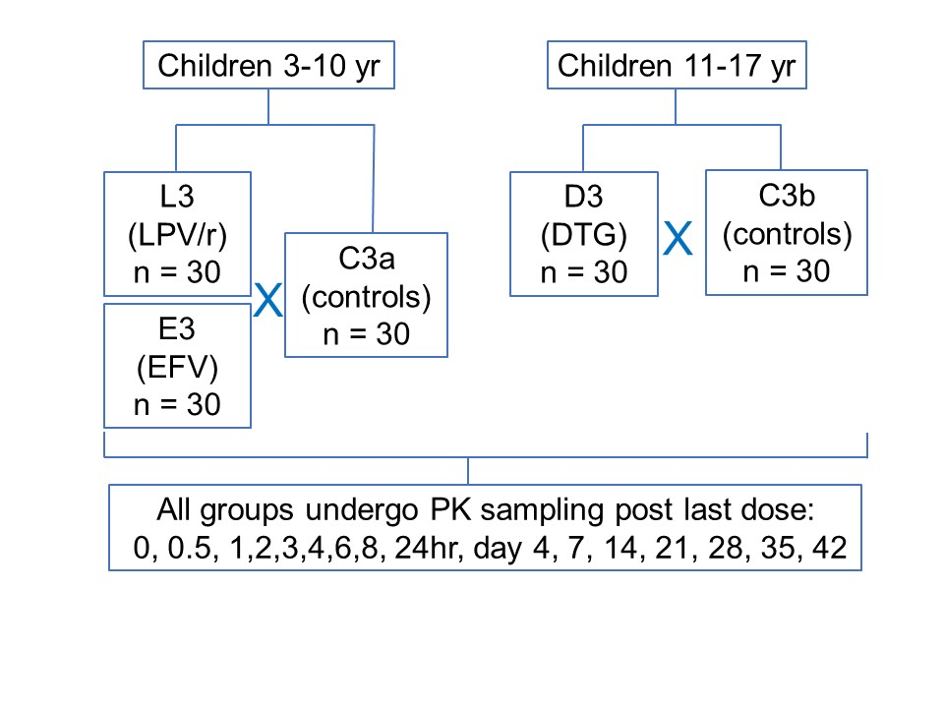
6814
Pharmacokinetics of piperaquine when used as malaria chemoprevention in HIV-infected children on antiretroviral therapy in Uganda
Richard Kajubi¹, Malik Koire², Meghan Whalen³, Florence Marzan³, Xay Pham³, Justin Goodwin⁴, Martina Wade⁴, Kacey Richards⁴, Grace Kisitu², Francesca Aweeka³, Liusheng Huang³, Norah Mwebaza¹, Sunil Parikh⁴,
¹Infectious Diseases Research Collaboration, Kampala, Uganda, ²Baylor College of Medicine, Kampala, Uganda, ³University of California, San Francisco, San Francisco, CA, United States, ⁴Yale School of Public Health, New Haven, CT, United States
,
Contact: Richard Kajubi.
Dept. of Pharm. at MUK
Tel: +256776211591
Email: rkajubi@gmail.com
Introduction
Table 2. PK parameters of piperaquine in children in the context of DTG-based antiretroviral therapy
Dihydroartemisinin-piperaquine (DHA-PPQ) is increasingly used for malaria treatment and considered for malaria chemoprevention.
These regions are often co-endemic for both malaria and HIV
PPQ is metabolized by cytochrome p450 CYP3A4 leading to drug-drug interactions (DDI) between DHA-PPQ and antiretroviral therapy when co-administered.
Suboptimal or elevated pharmacokinetic (PK) exposure may result with efavirenz (EFV)- and lopinavir/ritonavir (LPV/r)-based antiretroviral therapy, respectively, compromising efficacy, toxicity, and risking the emergence and/or spread of drug resistance.
Dolutegravir (DTG), which is currently the most widely used antiretroviral in sub-Saharan Africa, has not been extensively evaluated for DDIs.
 | HIV+ children | HIV- children
 | (DTG) | Control
PK parameters | GM; 90%CI (n=30) | GM; 90%CI (n=30) | GMR | P value
C_{max}, ng/mL | 285 (224, 363) | 272 (221, 334) | 1.05 | 0.73
T_{max}, hr | 3.04 (2.94, 6.02) | 4.02 (3.00, 6.05) | 1.320 | 0.16
t_{1/2},hr* | 434 (386, 487) | 400 (346, 461) | 1.090 | 0.4
AUC_{0-day21}, hr·ng/mL | 11.5 (9.24, 14.3) | 14.7 (12.5, 17.2) | 0.782 | 0.16
AUC_{0-day28}, hr·ng/mL | 12.7 (10.3, 15.7) | 16.4 (14.1, 19.1) | 0.774 | 0.13
AUC_{0-day42}, hr·ng/mL | 14. 9(12.0, 18.2) | 19.2 (16.6, 22.2) | 0.776 | 0.1
C_{7d_cap}, ng/mL | 39.1 (31.8, 48.0) | 37.2 (29.4, 47.0) | 1.050 | 0.68
C_{21d_cap}, ng/mL | 14.0 (11.8, 16.5) | 18.1 (15.5, 21.1) | 0.773 | 0.081
C_{28d_ven}, ng/mL | 5.44(4.23, 6.68) | 8.01 (6.90, 9.30) | 0.679 | 0.0199
C_{42d_ven}, ng/mL | 5.01 (4.12, 6.10) | 13.8 (11.0, 17.2) | 0.363 | <0.0001
LPV/r
+175%
DTG
-32%
Method
Note: GM: geometric mean; CI: confidence interval; GMR: geometric mean ratio (DTG/control);
* n=29 for DTG and 26 for control. Tmax was median (IQR)
EFV
-84%
Clinical trial design: We conducted a prospective open-label PPQ PK study in the context of EFV-, LPV/r- and DTG-based antitretroviral regimens among HIV-infected Ugandan malaria-uninfected children alongside HIV-uninfected controls.(Figure 1). DHA-PPQ was given once daily for 3 days at the WHO weight-based recommended dose.
Table 3. PK parameters of piperaquine in children in the context of LPV/r- and EFV-based antiretroviral therapy.
CT (11-17yr)
DTG
CT (3-10yr)
LPV/r
EFV
 | HIV+ children |  | HIV- children | GMR (p value)
 | EFV (n=30)* | LPV (n=30) | Control (n=30) | EFV/control | LPV/control
PK parameters | GM; 90%CI | GM; 90%CI | GM; 90%CI
C_{max}, ng/mL | 243 (202, 292) | 491 (397, 608) | 218 (175, 272) | 1.11 (0.53) | 2.25 (0.0001)
T_{max}, hr | 4.02 (2.97, 6.05) | 3.04 (2.00, 6.02) | 3.00 (2.98, 6.10) | 1.34 (0.41) | 1.01 (0.98)
t_{1/2}, hr** | 209 (179, 244) | 414 (364, 471) | 435 (377, 502) | 0.480 (<0.0001) | 0.952 (0.49)
AUC_{0-day21}, hr·ng/mL | 4.17 (3.56, 4.88) | 36.7 (30.7, 44.0) | 11.2 (9.71, 12.9) | 0.372 (<0.0001) | 3.28 (<0.0001)
AUC_{0-day28}, hr·ng/mL | 4.33 (3.71, 5.06) | 41.6 (34.8, 49.9) | 12.5 (10.9, 14.4) | 0.346 (<0.0001) | 3.33 (<0.0001)
AUC_{0-day42}, hr·ng/mL | 4.47 (3.83, 5.22) | 49.7 (41.7, 59.2) | 14.6 (12.7, 16.7) | 0.306 (<0.0001) | 3.40 (<0.0001)
C_{7d_cap}, ng/mL | 8.16 (6.88 (9.69) | 119 (96.2, 146) | 28.7 (24.4, 33.7) | 0.284 (<0.0001) | 4.15 (<0.0001)
C_{21d_cap}, ng/mL | 2.24 (1.76, 2.88) | 47.0 (37.7, 58.6) | 14.9 (12.9, 17.1) | 0.150 (<0.0001) | 3.15 (<0.0001)
C_{28d_ven}, ng/mL | 1.03 (0.873, 1.22) | 17.6, 13.6, 22.8) | 6.41 (5.38, 7.65) | 0.161 (<0.0001) | 2.75 (<0.0001)
C_{42d_ven}, ng/mL | 0.757 (0.645, 0.888) | 17.8 (14.9, 21.3) | 9.34 (7.35, 11.9) | 0.081 (<0.0001) | 1.91 (0.0006)
Figure 3. Box plot of day-28 PPQ in children receiving DHA-PPQ as chemoprevention with concomitant antiretroviral regimens. CT (11-17 yr), DTG controls; DTG, dolutegravir; CT (3-10yr), controls for LPV/r and EFV; LPV/r, lopinavir/ritonavir; EFV, efavirenz.
Childhood maturation
LPV/r
+91%
Figure 1. Study population
DTG
-64%
Determination of PPQ concentration: A validated LC-tandem mass method was used to determine [PPQ]¹. The calibration range was 0.5- 250 ng/mL.
EFV
-92%
PK data analysis: Noncompartmental analysis was performed with Phoenix WinNonlin version 8.3.1 (Certara, Princeton, NJ) using the linear up log down trapezoidal rule. PK parameters C_{max}, T_{max}, T_{half}, AUC_{0-21d}, AUC_{0-28d}, and AUC_{0-42d} were calculated for comparison. STATA version SE14.1 was used for the statistical analyses.
Results
CT (11-17yr)
DTG
CT (3-10yr)
LPV/r
EFV
Two control groups were used: the older children for DTG and younger children for LPV/r and EFV (Table 1). PK data are shown in Table 2-3 and Figure 2. The box plot for day 28 and 42 PPQ are shown in Figure 3 and 4.
Figure 4. Box plot of day-42 PPQ in children receiving DHA-PPQ as chemoprevention with concomitant antiretroviral regimens. CT (11-17 yr), DTG controls; DTG, dolutegravir; CT (3-10yr), controls for LPV/r and EFV; LPV/r, lopinavir/ritonavir; EFV, efavirenz.
Table 1. Demographic data of study participants
Conclusions
 | Controls |  | Concomitant ART
 | 10-17yr (n=30) | 3-10yr (n=30) | DTG (n=30) | LPV/r (n=30) | EFV (n=30)
Age (yr) Median(IQR) | 15 (13.8 – 16.3) | 7.4 (6.0 – 8.7) | 15.3 (13.6 - 17.1) | 7.1 (6.0 – 8.7) | 7.9 (6.6 – 9.1)
Weight (kg) Median (IQR) | 42.4 (35.4 – 53.5) | 23.6 (21.4 – 27.9) | 48.7 (38.7 – 53.4) | 19 (17.4 – 22.5) | 21.4 (18 – 26.2)
Height (cm) Median(IQR) | 152.5 (148.8 – 160.3) | 123 (118.8 – 130.3) | 154 (147.8 – 163.3) | 115 (108.2 – 123.6) | 119.8 (112.3 – 128.4)
BMI (kg/m2) Median(IQR) | 18.1 (16.1 – 19.6) | 15.6 (14.9 – 16.3) | 20 (12.9 – 20.8) | 14.8 (14.4 – 15.1) | 15.1 (14.6 – 15.8)
Hemoglobin (g/dL) | 12.7 (12.0 – 13.6) | 11.9 (10.8 – 12.7) | 13.8 (12.6 – 15.5) | 12.9 (11.8- 13.6) | 12.5 (11.9 – 13.0)
Male n(%) | 13 (43.3) | 19 (63.3%) | 17(56.7%) | 15 (50%) | 11 (36.7)
DHA (mg/kg/dose) | 2.2 (1.7 - 3.4) | 2.7 (2.4 - 3.8) | 2.4 (1.7 - 3.1) | 3.0 (2.4-3.5) | 3.1 (2.5 - 3.5)
Total weight adjusted DHA (mg/kg | 6.5 (5.2 - 10.2) | 8.2 (7.1 - 11.4) | 7.3 (5.0 - 9.4) | 8.9 (7.1 -10.5) | 9.2 (7.4 - 10.5)
PQ (mg/kg/dose) | 17.4 (13.9 -27.3) | 22.0 (18.9 - 30.5) | 19.4 (13.2 - 25.1) | 23.6 (18.9 - 27.9) | 24.7 (19.7 - 28.1)
Total weight adjusted PQ (mg/kg) | 52.2 (41.7 - 81.8) | 65.9 (56.8 - 91.4) | 58.2 (39.7 - 75.2) | 70.9 (56.8 - 83.7) | 74.0 (59.0 - 84.2)
1. DTG did not impact PPQ total exposure but decreased terminal PPQ exposure by 1.3- to 2.8-fold.
2. LPV/r increased total PPQ exposure by 3.3 fold and increased terminal PPQ by 2- to 4-fold.
3. EFV decreased total PPQ exposure by 3-fold and decreased terminal PPQ even more significantly by 7- to 10-fold.
4. The impact of DTG and EFV on terminal PPQ increased over time, but the impact of LPV/r on terminal PPQ diminished over time.
5. HIV-infected children on EFV- and LPV/r-based antiretroviral regimens have opposing effects on PQ exposure, which may impact efficacy and toxicity, respectively, while reductions in the terminal PQ exposure in those on DTG may reduce the duration of post-treatment malaria chemoprophylaxis.
References and Funding
Figure 2. Mean plasma concentration versus time profile for PPQ in children. Top panel: Control (black line), DTG (green line). Bottom panel: Control (black line), LPV/r (green line) EFV (red line), data represent geometric mean, error bars represent 95% confidence interval.
1. Kjellin, et al. Bioanalysis, 2014, 6 (23):3081-3089.
This work was supported by the National Institutes of Health (R01 HD068174)

