Slide 1

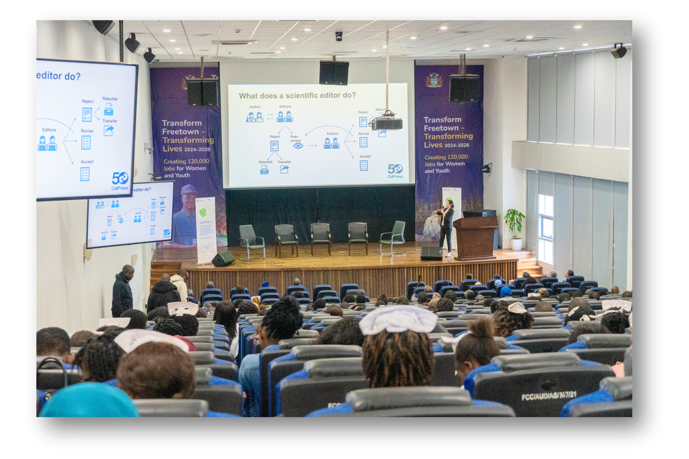

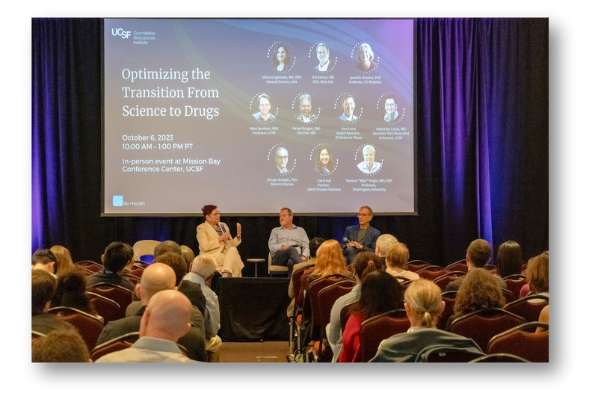

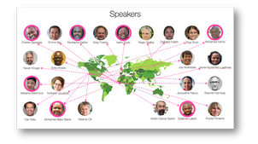

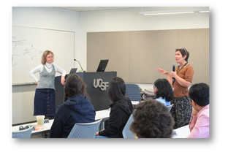
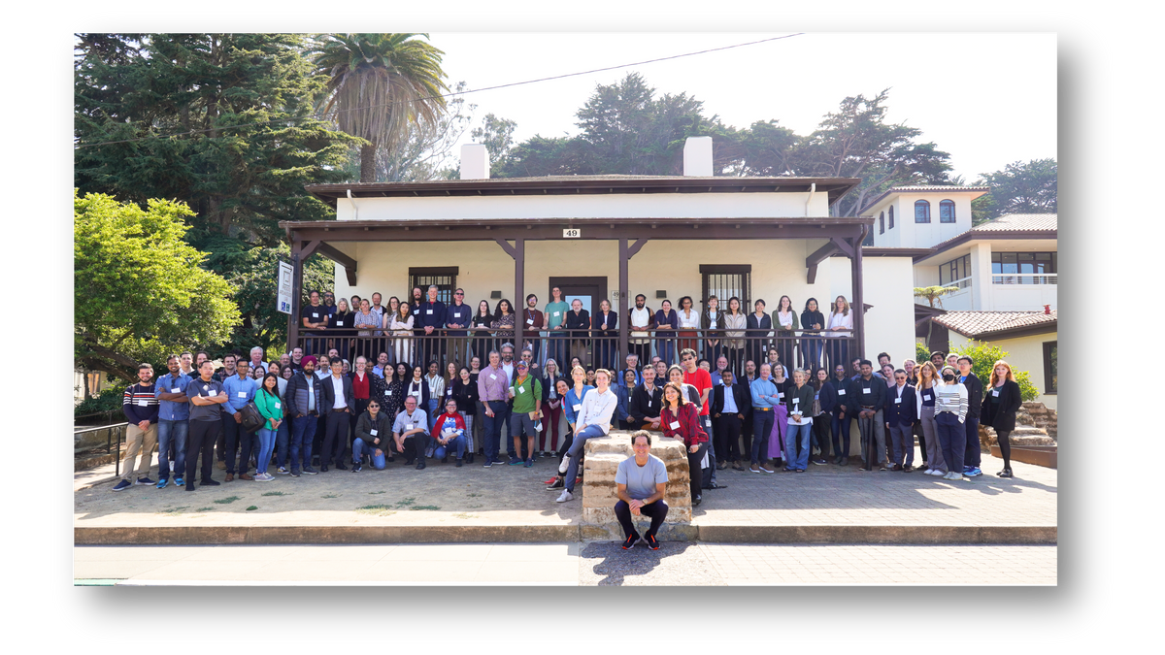
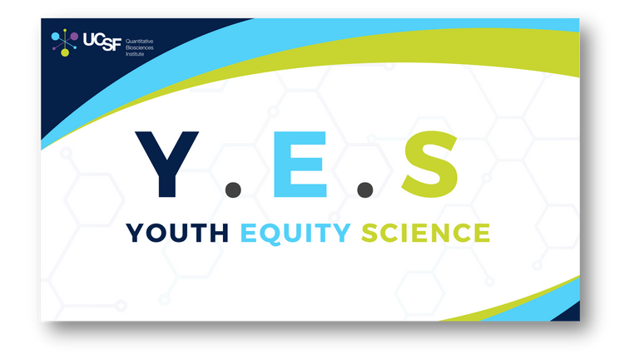

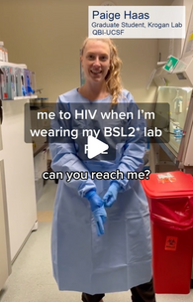
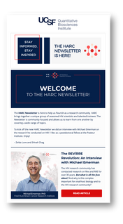



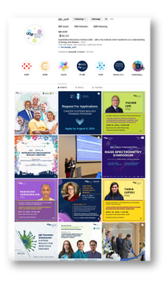
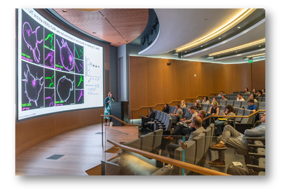
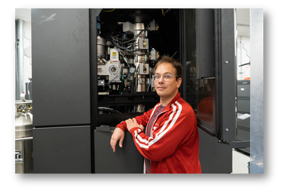


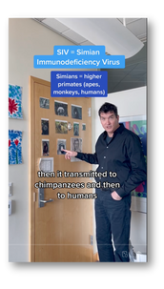


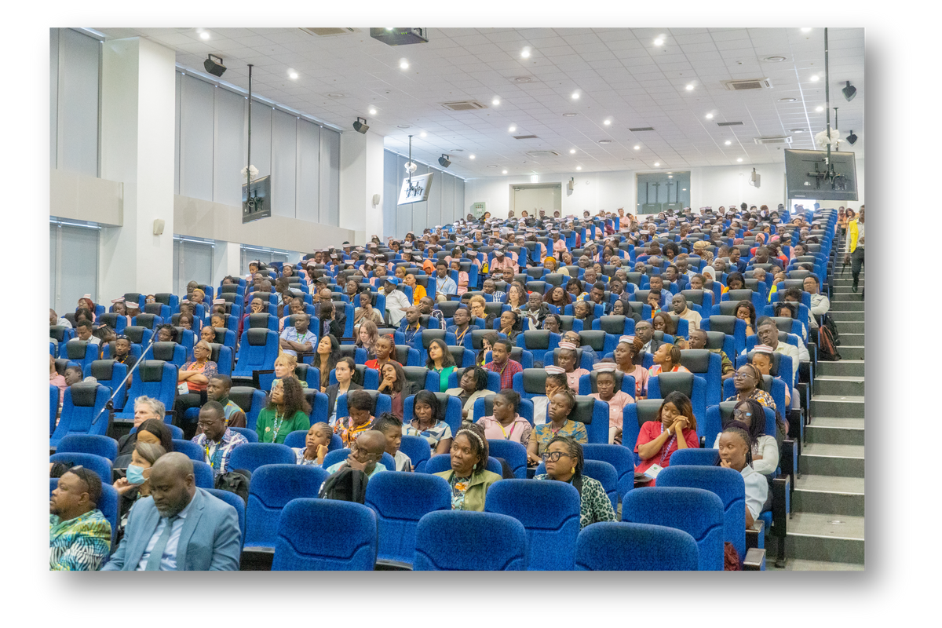

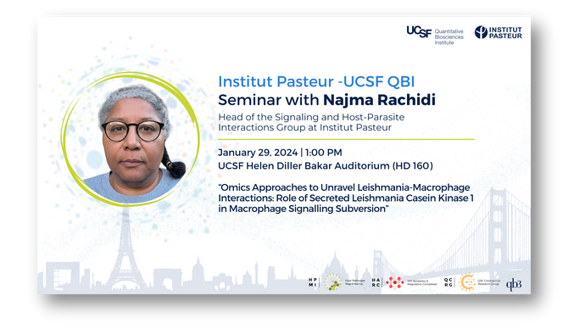
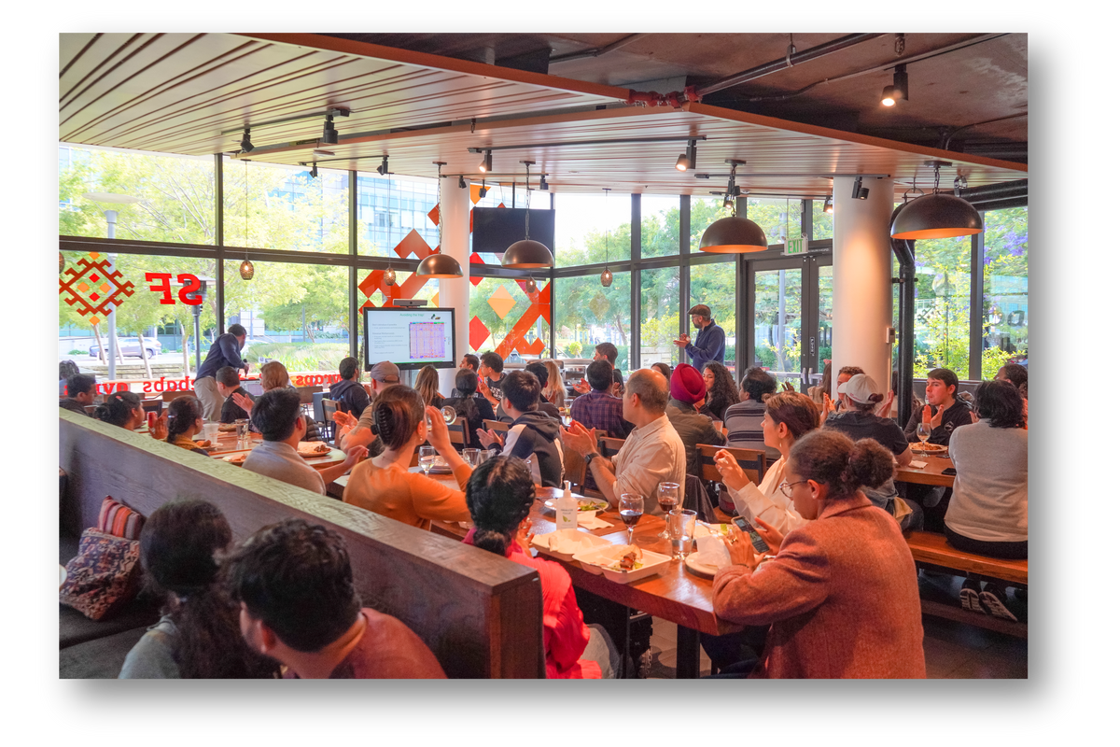
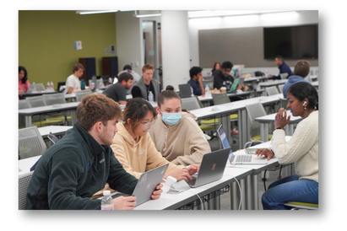
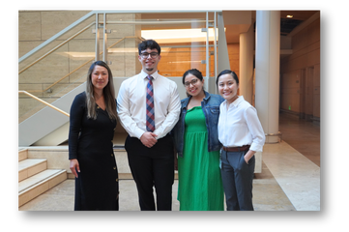


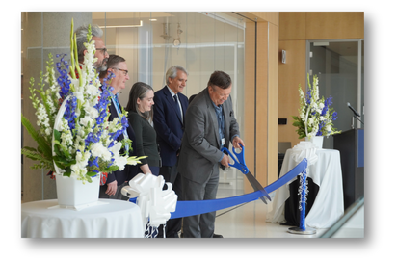

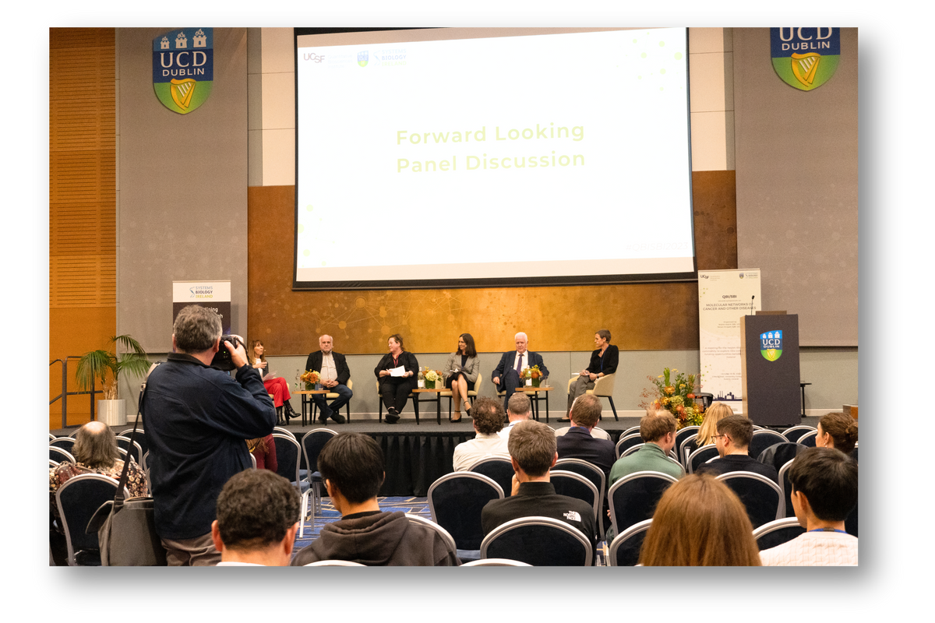
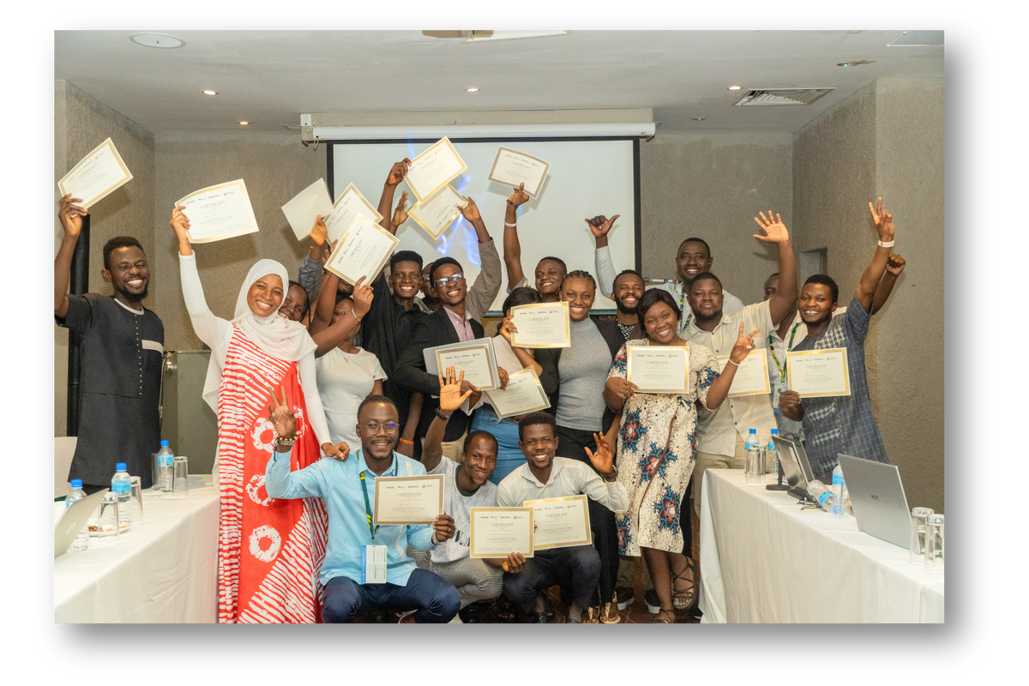
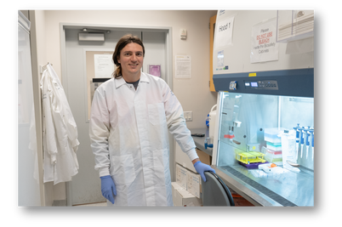
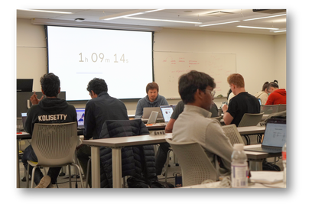


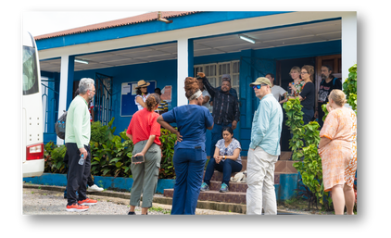



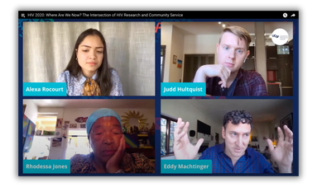







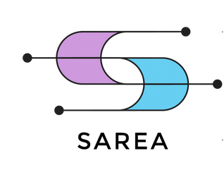
Breaking Down Silos and
Creating New Paradigms for Collaborative Research
Jacqueline Fabius, Kirsten Obernier, Zelda Love, Gina Nguyen, Saumya Gopalkrishnan, Alexa Rocourt, Reshmi Tognatta, Manon Eckhardt, Celine Perier, Sarika Parehk, Ali Sasan, Swathi Sukumar, Peggy Ackerberg, Margaret Soucheray, Nevan Krogan
Vision
Goals
Highlighted SubGoals
Collaborations
QBI is focused on breaking down silos and bringing together scientists from different disciplines, technologies and disease areas as well as across academia and industry to focus on problems that can only be solved through team science. QBI specializes in developing quantitative research tools to provide deep mechanistic insights on the underlying biology behind different disease states, which helps facilitate these worldwide collaborative efforts.
  Ensure sustainable and diverse funding for scientific endeavors
  Initiate and build national and international collaborations
  Maintain a robust outreach and media presence
  Create a new paradigm for academic-industry collaboration to translate science into medicines
  Training of young, diverse scientists
  Creation of an organized approach for obtaining larger collaborative grants from federal agencies such as NIH and ARPA-H
  Foster and sustain international collaborations
  Push a creative, outreach and media presence
  Develop a new LLC structure collaborating with UCSF
  Creation of internships and learning spaces
    QBI Y.E.S internships
    Workshops at UCSF and in West Africa
Cell mapping and QBI Coronavirus Research Group (QCRG): The QBI vision has focused on team science through network mapping of the cell. With many genes already linked to various diseases, the next step is to map how the related proteins interact in healthy and diseased states. These disease agnostic approaches guide mechanistic and structural studies, connect to patient data, and unite scientists across disciplines.
International: QBI has leveraged its science to foster worldwide collaborations in Africa, Asia, Europe and South America and fostered joint efforts across academia and industry. These efforts include research, events and capacity building.
Accomplishment Highlights
First International West Africa Symposium
on Infectious Diseases in Sierra Leone
“Optimizing the Transition from Science to Drugs” panel discussion
QBI Coronavirus Research Group
QBI Y.E.S.
DEI outreach program
Outreach and Media
Freie Universität Berlin
Fellowship Program
Institut Pasteur Sabbatical Program
University College Dublin
Grand opening of the Bruker Center of Excellence in Proteomics
Hackathons
Outreach & Media
Challenges
Future Directions
QBI-based Companies
QBI aims to make science more accessible to audiences with diverse backgrounds and education levels by leveraging various communication platforms including websites, newsletters, social media (LinkedIn, Twitter, Facebook, Instagram, TikTok), QBI TV (YouTube), and audio-based interviews (QBI in Space, “Biologist Being Basic” podcast).
  Maintaining sustainable funding
  Hiring support talent / administrative employee retention
  Prioritizing and follow up of international relationships
  Small media team to accomplish multiple goals and projects
  Remote / on-site working
  Secure funding for AI driven research
  Create an LLC in collaboration with UCSF
  Augment research on neuroscience, especially autism and schizophrenia
  Analysis of international collaborations and sustainability plan
  Monthly SOP team and Dean reports
  Identify candidates for the QBI Scholarship for Women from the Global South in Biosciences
REZO
Using network-based and AI methods to uncover novel targets and unique therapeutic approaches for oncology.
SAREA
A new model for industry-academia to accelerate the discovery and the development of new medicine across many disease areas.

