Slide 1
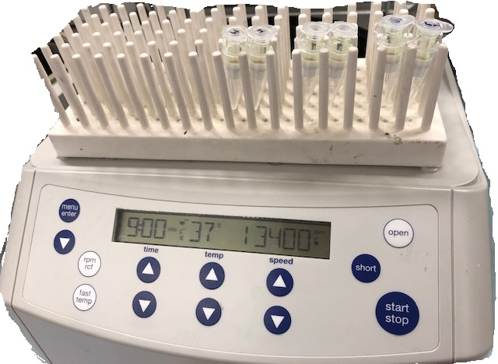
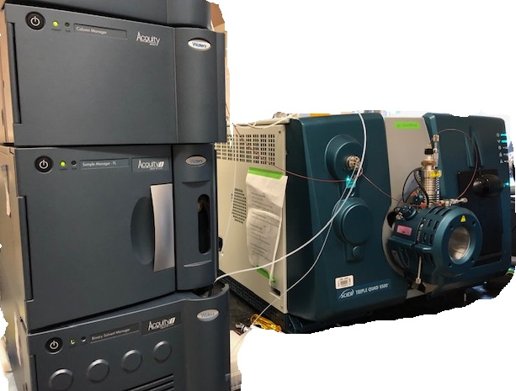
T1530-11-74
Determination of unbound piperaquine in human plasma
Liusheng Huang¹, Vong Sok¹, Erika Wallender¹, Grant Dorsey², Philip Rosenthal², Francesca Aweeka¹
¹Drug Research Unit, Department of Clinical Pharmacy and ²Department of Medicine, University of California
San Francisco
CONTACT INFORMATION: Liusheng.huang@ucsf.edu.
PURPOSE
Piperaquine (PQ) is a highly protein-bound drug commonly combined with dihydroartemisinin for the treatment and prevention of malaria. Variation in plasma protein contents during pregnancy and infancy may affect the pharmacokinetic exposure of unbound drug, leading to alteration of clinical outcomes. Previously we reported total PQ exposure was 40% lower in pregnant women and children compared to non-pregnant adults, but unbound PQ exposure remains unclear. Therefore, we developed a LC/MS/MS method to determine unbound PQ exposure in human plasma.
Result(S)
Application: We carried out a pilot analysis of clinical samples from two pregnant woman. When the method was applied to the 1st subject, there was an interfering peak for PQ. We resolved it after mobile phase B was modified to methanol-acetonitrile (4:1) with 0.1%TFA. The concentration-time profile of unbound and total PQ from a pregnant woman is shown in Fig. 3. The unbound PQ ranged from 0.19 -0.39% of the total PQ concentration.
Conclusion(S)
A sensitive LC-MS/MS method was developed for quantification of unbound PQ in human plasma with an LLOQ at 0.02 ng/mL. To our best knowledge, this is the most sensitive method for PQ quantitation. Application to a clinical pharmacokinetic study is ongoing.
Ultrafiltration: To test for nonspecific binding on the ultrafiltration device, PQ was dissolved in 10% acetonitrile 0.5% formic acid and the solutions were directly filtered through the device. We observed 50% binding to the filter devices at 10 ng/mL PQ and 29% at 100 ng/mL PQ. However, following treatment of the filters with 5% BAK, PQ was fully recovered from the ultrafiltration (Table 3).
Validation: the method was validated based on the guidelines from NIH-funded Clinical Pharmacology Quality Assurance Program. Calibrators (0.02, 0.05, 0.1, 0.2, 05, 1, 2, 5 ng/mL) and QC samples (0.06, 1.5, 4 ng/mL) were prepared in plasma filtrate with or without BAK pre-treatment.
Intra-inter-day precision and accuracy were within ±15% (Table 4).
Matrix effect was evaluated with 6 lots of plasma filtrate spiked with 0.06, 1.5, 4 ng/mL PQ. The CV% of slopes from linear regression of the 6 lots samples was 3.2% (<5%), suggesting matrix effect did not impact quantitation of PQ.
MS/MS optimization: APCI⁺ was used to minimize matrix effect that was significant when ESI⁺ was used.
Note: T, source temperature, CUR, curtain gas, NC, nebulizer current, Gas 1, ion source gas, CAD, collision-assisted dissociation. DP, declustering potential, EP, entrance potential, CE, collision energy, CXP, collision cell exit potential.
LC optimization: PFP (30x2.1mm, 1.7µm, Waters Corp) was used for separation, which retained PQ better than PFP(50x2.1mm, 1.9µm, Agilent Tech). The mobile phase A=20mM NH₄FA, 0.14%TFA, B=0.1%TFA in acetonitrile [later modified to methanol-acetonitrile(4;1, v/v)]. Flow rate 0.8mL/min.
With the gradient program (Table 2), the retention times for PQ and the IS (PQ-d₆) are both 0.68min (Fig.2).
Table 1. Optimized MS/MS parameters
Source parameters | T, °C | CUR | NC | Gas1 | CAD
 | 400 | 30 | 4 | 45 | 9
Compound parameters | DP | EP | CE | CXP | Time, ms
PQ, 535/288 | 86 | 10 | 45 | 9 | 50
PQ-d₆ (IS), 541/294 | 85 | 10 | 45 | 9 | 50
Table 3. | Direct filtration |  | Pretreated with BAK
PQ, ng/mL | 10 | 100 | 0.1 | 10
Recovery, % | 50 | 71 | 103 | 104
Fig.3. Concentration-time profile for unbound and total PQ
from a pregnant woman receiving PQ chemoprevention.
OBJECTIVE(S)
To develop a sensitive method for quantitation of unbound PQ in human plasma with a lower limit of quantification (LLOQ) of ≤50 pg/mL.
Method(S)
Ultrafiltration: Microcon Ultracel® centrifugal filters (10k NMWL) were used to remove protein- bound drug. Plasma (100µL) was added to the benzalkonium chloride (BAK) treated filter cup and centrifuged at 13,400 rcf at 37 ºC for 9 min. The filtrate was mixed with ½ volume of PQ-d₆ (IS).
LC-MS/MS system: A Sciex TripleQuad 6500+ Tandem Mass Spectrometer coupled with a Water UPLC (I Class) system was used (Fig 1).
Table 2. LC gradient
Time, min | 0 | 0.1 | 1.0 | 1.40 | 1.41 | 1.50
Sovent B,% | 30 | 30 | 80 | 80 | 30 | 30
FUNDING/acknowledgment
This work was supported by NIAID (# R01AI117001 and 4P01HD059454-09). We thank Amelia Deitchman, David Gingrich and Florence Marzan.
Fig. 1. Work flow
Table 4 | Intra-day |  |  |  | Inter-day
Nominal* | 0.02 | 0.06 | 1.5 | 4 | 0.02 | 0.06 | 1.5 | 4
CV% | 6.2-15 | 4.4-11 | 4.7-11 | 2.5-8.6 | 12 | 9.7 | 8.5 | 7.0
Dev% | 3.8-15 | -8.9-1.6 | -7.3-3.2 | -0.67-9.8 | 9.9 | -4.9 | -2.9 | 4.2
n | 6 | 6 | 6 | 6 | 18 | 18 | 18 | 18
100 µL plasma

