Slide 1
Host Genomics in WIHS
The WIHS GWAS data set
Concept Sheet
Data use agreement
Data transfer
Analytic support

Slide 2
Host Genomics in WIHS
The WIHS GWAS data set
Concept Sheet
Data use agreement
Data transfer
Analytic support

Slide 3
The GWAS Data set
3700 / 3740 WIHS participants submitted for GWAS
Approximately 5 millions single nucleotide polymorphisms (SNPs)
  2.5 million “common” SNPs (>5% MAF)
  2.5 million “rare” SNPs (<5% MAF)
Imputation (additional 8 million SNPs)

Slide 4
The GWAS Data set
Quality control analyses revealed excellent quality.
Failed samples (i.e., low call rate, insufficient DNA)
  2.8% (95 samples); 57 of 95 passed repeat analysis
DNA sample call rate (passed SNP/total SNP):
  100% with call rates exceeding 97.5%.
SNP call rate (proportion of samples with valid genotypes)
  2,420,602 of 2,443,179 assays (99.1%) had Gentrain scores ≥ 0.8.
    2,253,850 exceeded a call rate of 99%
    2,391,865 exceeded a call rate of 97.5%
    2,419,923 exceeded a call rate of 95.0%
    Only 678 assays (0.028%) displayed call rates less than 95%.
Duplicate genotype concordance (2,443,179 SNP assays)
  Among 62 pair duplicate samples exceeded 97.6%.
Batch and array level resampling
  No evidence of batch effects was found

Slide 5
Host Genomics in WIHS
The WIHS GWAS data set
Concept Sheet
Data use agreement
Data transfer
Analytic support

Slide 6
Concept Sheet: host genomics
Considerations for host genomics
  Table of genes required for candidate gene study
  If using GWAS dataset, sections 5 & 6 not required
    Section 5: laboratory methods
    Section 6: QA/QC
  If proposing new genotyping, you must substantiate why the GWAS data is not sufficient
    Examples
      non-SNP poorly captured by available SNPs
      Region containing the SNP poorly covered by GWAS
Pre-submission review offered

Slide 7
Host Genomics in WIHS
The WIHS GWAS data set
Concept Sheet
Data use agreement
Data transfer
Analytic support

Slide 8
Data Use Agreement
Agreement between investigator, WIHS contact, and WIHS to
  Pursue maximum reasonable security measures
  Agree to destroy the genetic data files upon successful completion of the study (i.e., publication)
  Notify WDMAC in the event of a breach of security/loss of confidentiality

Slide 9
Host Genomics in WIHS
The WIHS GWAS data set
Concept Sheet
Data use agreement
Data transfer
Analytic support

Slide 10
Foundation for secure transfer
Request verified by examining Concept Sheet

Slide 11
Encrypting data

Slide 12
Decrypting data

Slide 13
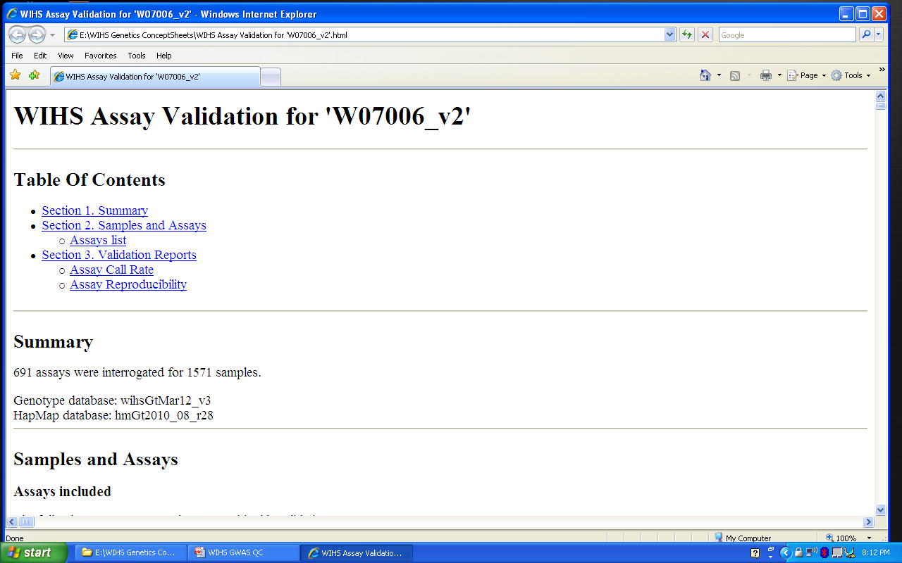
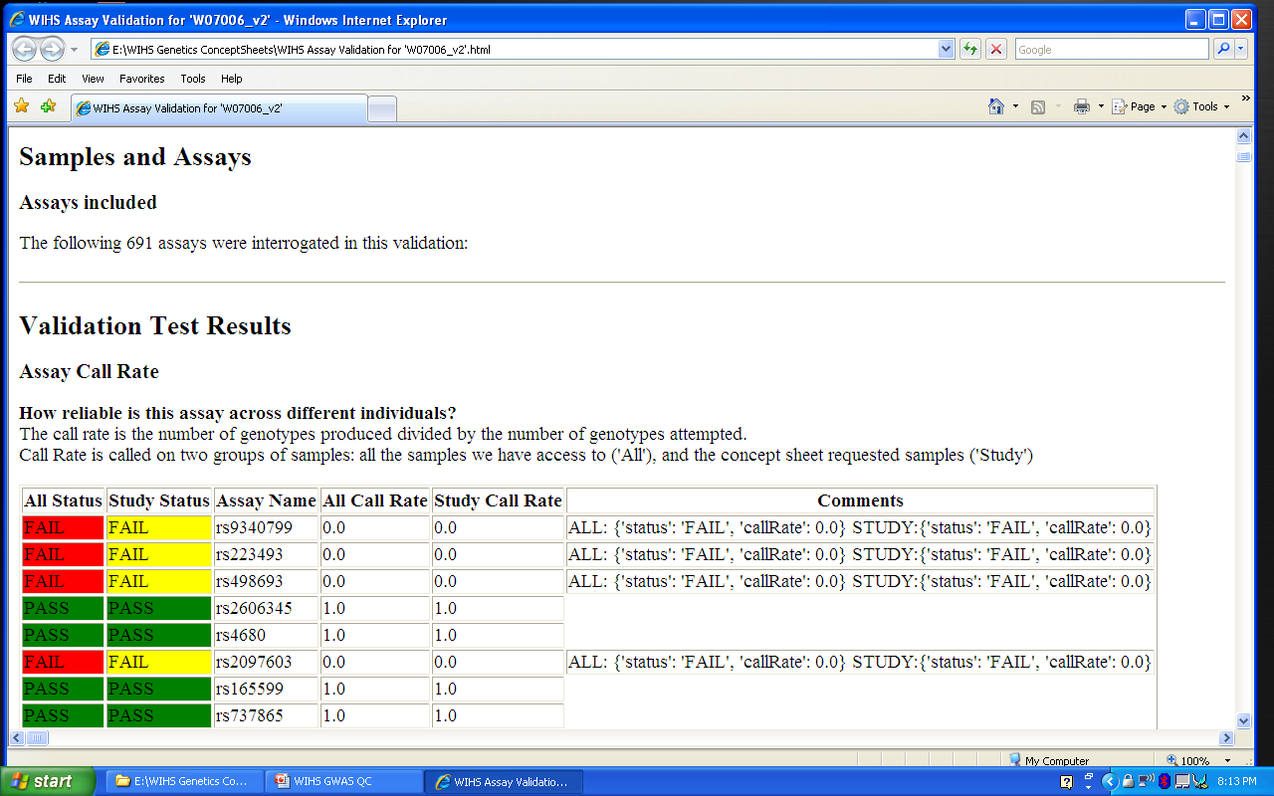
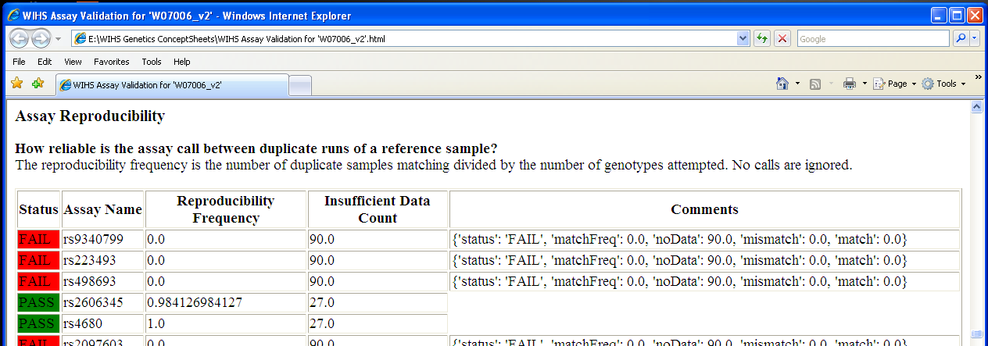
WIHS Assay Validation Report

Slide 14
Host Genomics in WIHS
The WIHS GWAS data set
Concept Sheet
Data use agreement
Data transfer
Analytic support
  Special note on racial and ethnic heterogeneity

Slide 15
Analytic Support
Pre-submission Concept Sheet review
Evaluation of and assistance with study design and the data analysis plan.
Potential involvement as a co-Investigator to provide
  Analytic support
  Assistance with dissemination

Slide 16
Approaches to Race/ethnicity
Self-report only
Genomic estimates of self-reported race and ethnicity
Both
So, how do we estimate genetic ancestry?

Slide 17
Estimating race/ethnicity
Select “ancestry informative markers” from across the genome
Estimate latent subgroups using ancestry informative markers
  Note that this is a somewhat circular process and is not perfect
  Principle component analysis
Use these estimates jointly as covariates
  These PCs (n=10) are provided with all genomic data requests

Slide 18
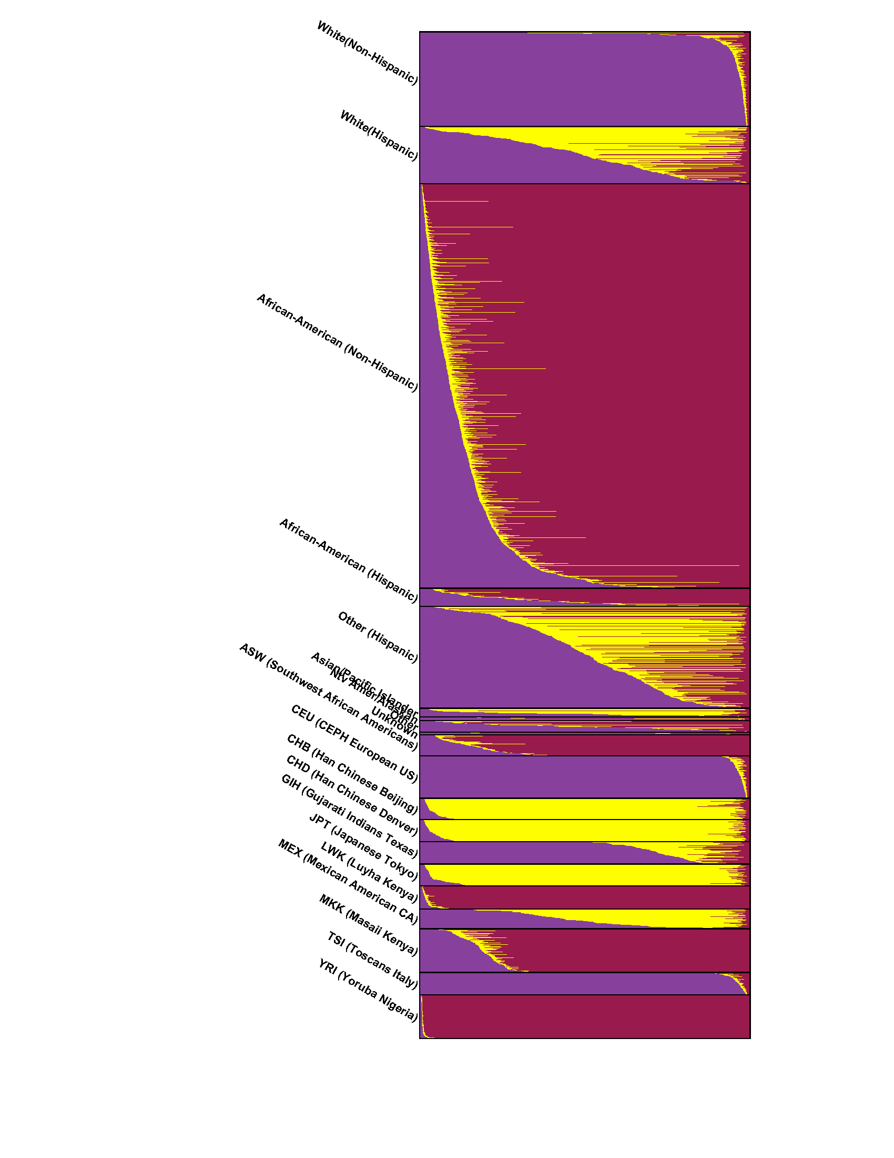
By Racial and Ethnic Group,
then by Caucasian Component gradient

Slide 19
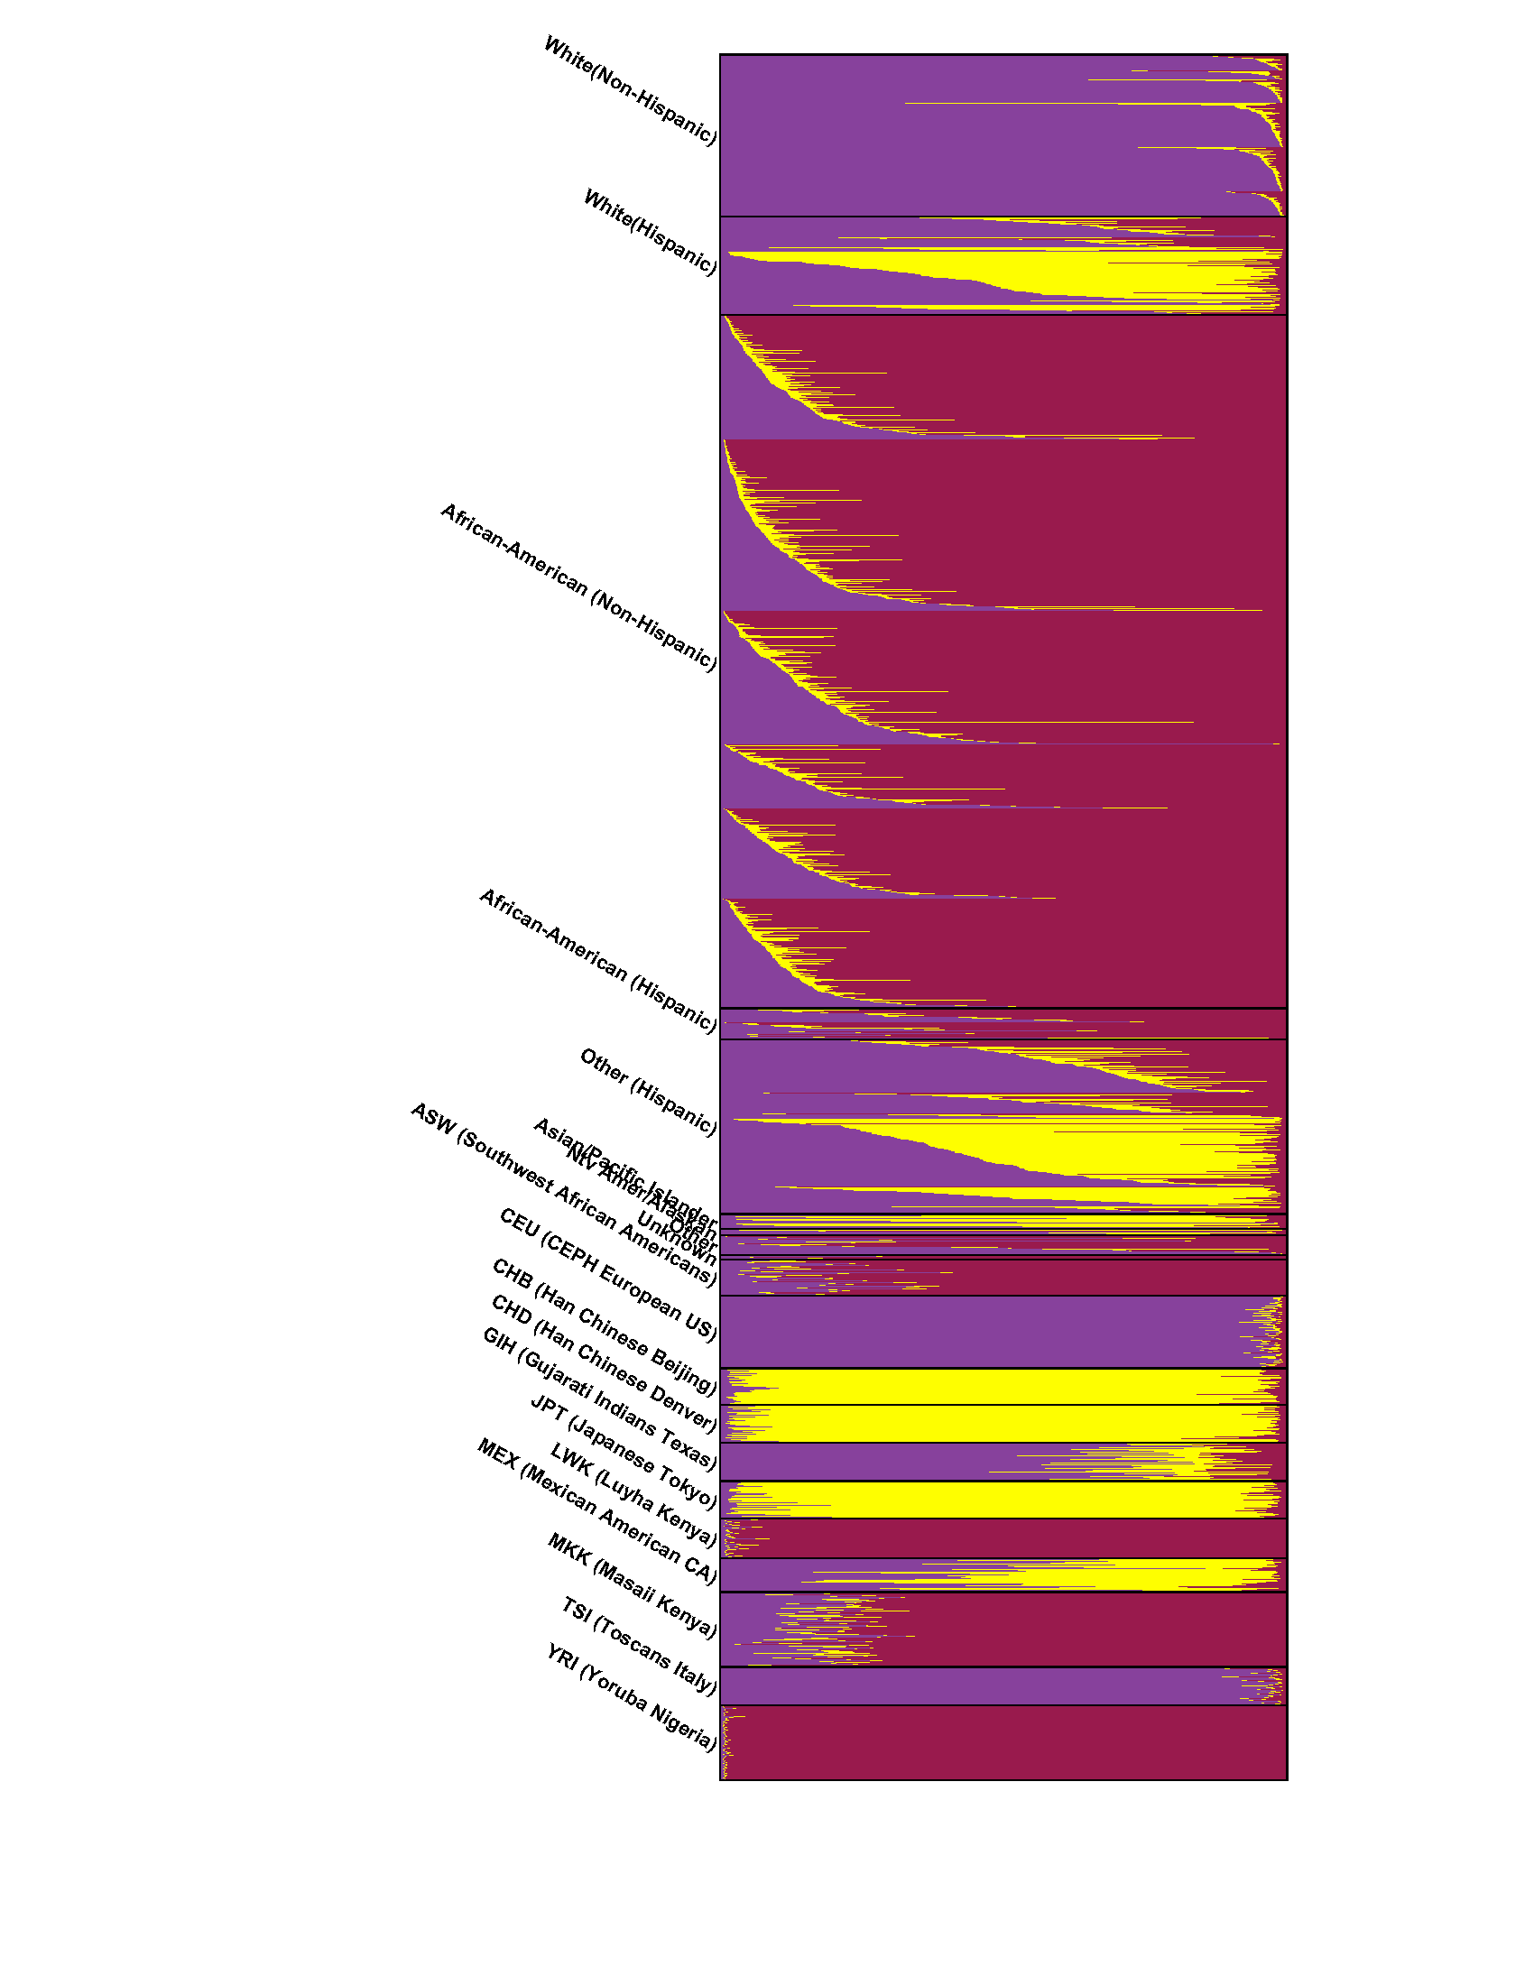
By Racial and Ethnic Group, then by Site,
then by Caucasian Component gradient

Slide 20
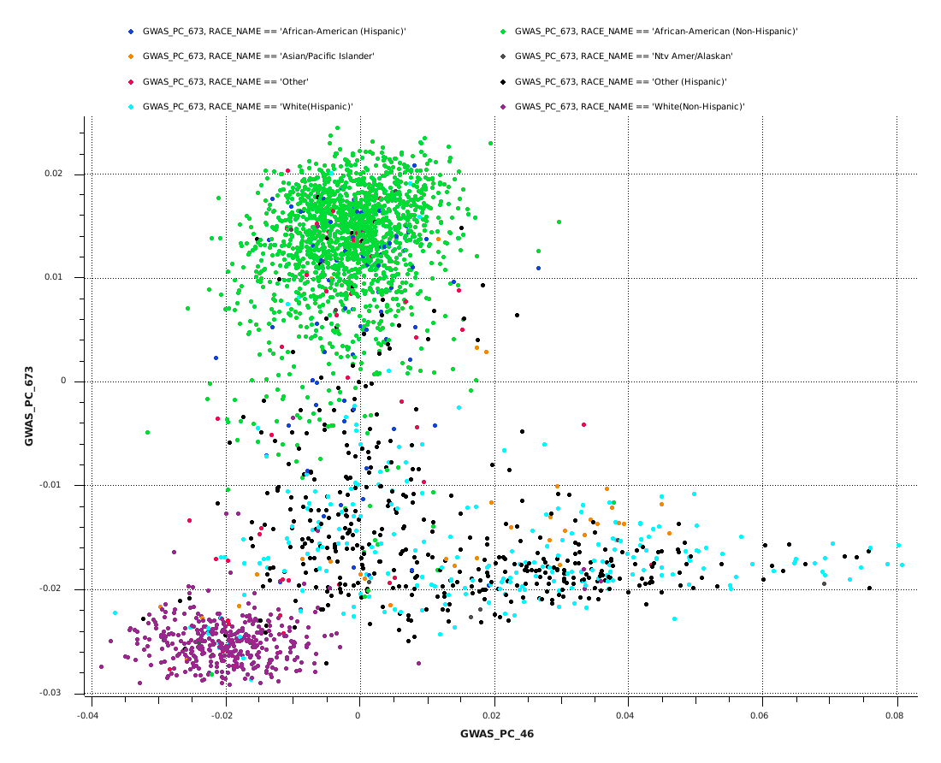
Principle components: PC1 vs PC2

Slide 21
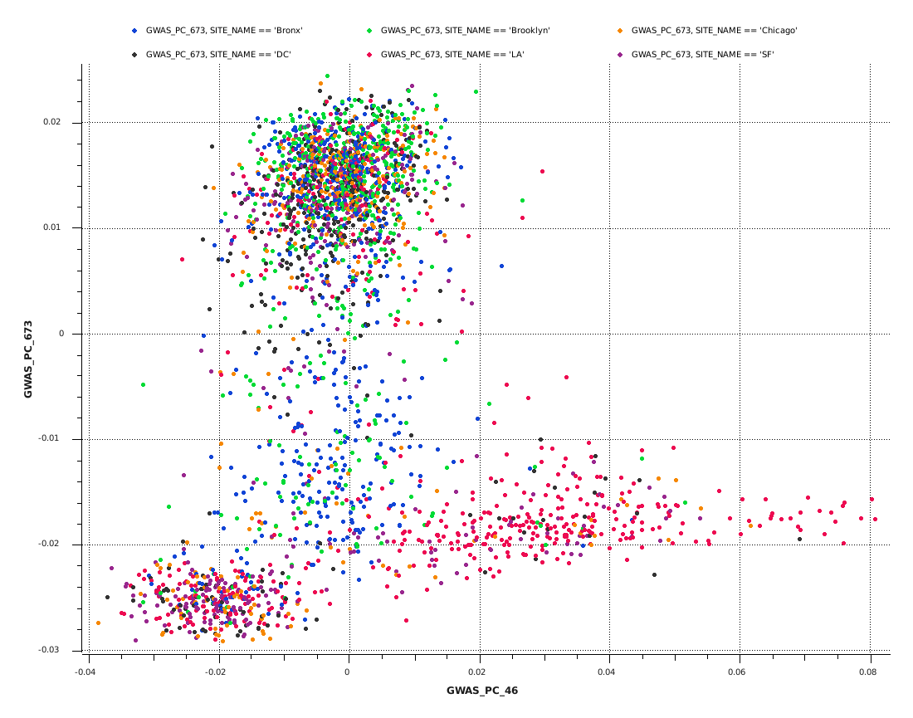
Principle components: PC1 vs PC2, by site

