Slide 1
Effects of HIV/HCV coinfection on Bone Mineral Density and Structure
Amber Wheeler, MD
WIHS Scientific Meeting
June 30, 2014

Slide 2

Objectives
To discuss:
Background
Aims
Preliminary “rough” data
Future Directions

Slide 3
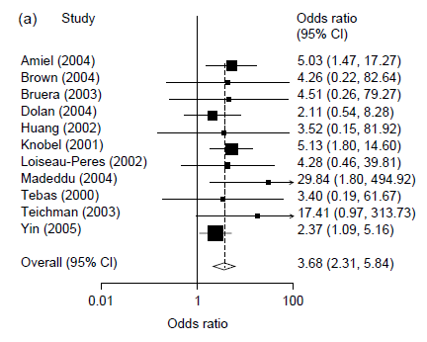
HIV-infected persons have increased odds of osteoporosis compared to uninfected persons
Comparing HIV-infected to HIV-uninfected
Brown, Qaqish. AIDS 2006
Notes:
meta-analytical review of cross-sectional studies . Prevalence of osteoporosis is 15%

Slide 4
HCV coinfection is an important factor predicting osteoporotic fracture in HIV-infected patients
Factors | Hazard Ratio (95% Confidence Interval; p value)
 | Univariate Analysis | Multivariable Analysis
White Race | 1.76 (1.04 - 2.09; p=0.03) | 1.88 (1.54 – 2.30; p< 0.001)
Age (per 10 year increase) | 1.51 (1.39-1.63; p < 0.001) | 1.50 (1.37 – 1.64; p< 0.001)
Tobacco Use | 1.25 (1.06 – 1.47; p=0.01) | 1.31 (1.09 – 1.56; p=0.003)
BMI < 20 | 1.61 (1.29 – 2.00; p<0.001) | 1.48 (1.18 – 1.87; p=0.007)
Diabetes | 1.27 (1.05 – 1.53; p=0.01) | 1.10 (0.90 – 1.34; p=0.34)
Cumulative ART Use (per year) | 1.05 (1.01 – 1.10; p=0.02) | 0.99 (0.95 – 1.04; p=0.77)
CKD (eGFR < 60) | 1.48 (1.04 – 2.09; p=0.03) | 1.05 (0.72-1.53; p=0.79)
HCV Coinfection | 1.43 (1.21- 1.69; p< 0.001) | 1.49 (1.25 – 1.77; p< 0.001)
Bedimo R, et al. IAS 2011. Abstract MOAB0101.

Slide 5
HCV coinfection is an important factor predicting osteoporotic fracture in HIV-infected patients
Factors | Hazard Ratio (95% Confidence Interval; p value)
 | Univariate Analysis | Multivariable Analysis
White Race | 1.76 (1.04 - 2.09; p=0.03) | 1.88 (1.54 – 2.30; p<0.001)
Age (per 10 year increase) | 1.51 (1.39-1.63; p<0.001) | 1.50 (1.37 – 1.64; p<0.001)
Tobacco Use | 1.25 (1.06 – 1.47; p=0.01) | 1.31 (1.09 – 1.56; p=0.003)
BMI < 20 | 1.61 (1.29 – 2.00; p<0.001) | 1.48 (1.18 – 1.87; p=0.007)
Diabetes | 1.27 (1.05 – 1.53; p=0.01) | 1.10 (0.90 – 1.34; p=0.34)
Cumulative ART Use (per year) | 1.05 (1.01 – 1.10; p=0.02) | 0.99 (0.95 – 1.04; p=0.77)
CKD (eGFR < 60) | 1.48 (1.04 – 2.09; p=0.03) | 1.05 (0.72-1.53; p=0.79)
HCV Coinfection | 1.43 (1.21- 1.69; p< 0.001) | 1.49 (1.25 – 1.77; p< 0.001)
Bedimo R, et al. IAS 2011. Abstract MOAB0101.

Slide 6
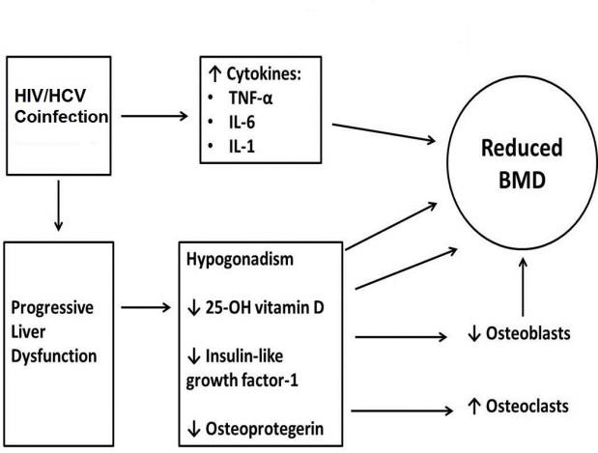
Proposed mechanism for reduced Bone Mineral Density (BMD) in HIV/HCV coinfection
Adapted from Lo Re, et al. Hept 2009

Slide 7
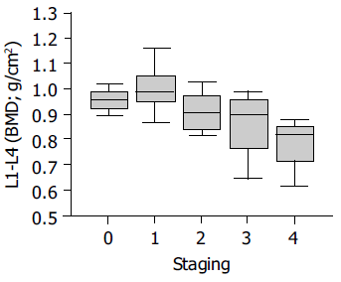
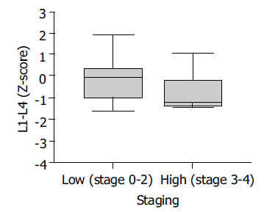
BMD was lower in the more advanced stages of biopsy-proven liver disease in subjects with viral hepatitis
Schiefke, et al. World J Gastroenterol 2005
Notes:
43 consecutive patients with chronic HBV or HCV infection participated (HCV-30, HBV-13)
Study group consisted of 12 men and 31 women with a median age of 49 years

Slide 8
Noninvasive serum markers to assess liver fibrosis
Indirect- Calculated using routine clinical labs
Direct
FIB-4
  Calculated using Age, ALT, AST, platelets
APRI
  Calculated using AST, platelets
**However, direct effects of the HIV infection itself can alter values used to calculate APRI and FIB-4
Enhanced Liver Fibrosis (ELF) score incorporates serum fibrosis markers of fibrin synthesis and degradation to make determinations of hepatic matrix metabolism

Slide 9
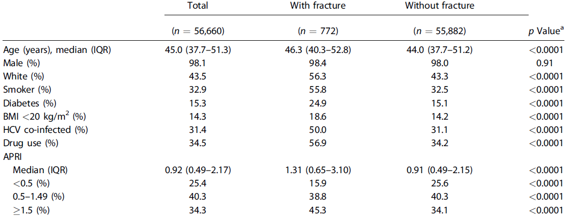
In addition to traditional risk factors, APRI was associated with increased fractures in HIV/HCV coinfection
Maalouf, et al. JBMR 2013

Slide 10
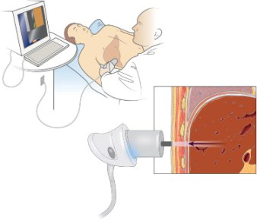
Noninvasive methods to assess liver fibrosis
Transient elastography (TE or Fibroscan®)
Allows for direct visualization of the liver
Pulse-echo ultrasound acquisitions follow the propagation of the shear wave, enabling its velocity to be measured
This velocity is directly related to tissue stiffness.

Slide 11
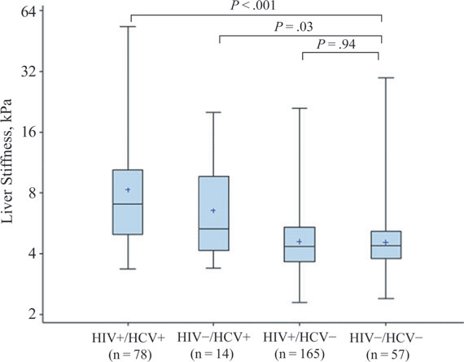
HIV/HCV-coinfected and HCV-monoinfected women had higher TE-LS values than those with neither HIV nor HCV infection
Bailony et al. JID 2013

Slide 12
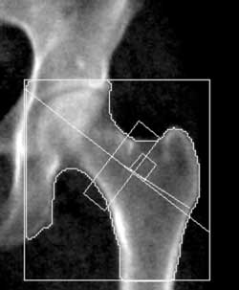
Areal BMD measured by DXA alone is insufficient to determine bone strength or quality
Cannot distinguish between cortical and trabecular bone
Does not provide information about bone microarchitecture and strength
Does not entirely capture architectural changes that occur as the result of aging, metabolic disorders or therapy
Shown to be an unreliable predictor of fracture
Kazakia, et al . Rev Endocr Metab Disord 2006.
Notes:
Cannot discriminate changes due to bone geometry from those purely due to increased bone density

Slide 13
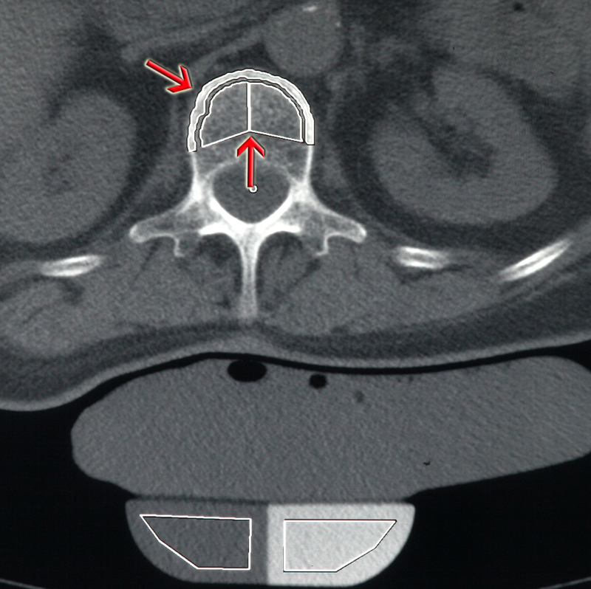
Quantitative Computed Tomography (QCT) assesses volumetric BMD
Allows examination of the separate contributions of cortical and trabecular bone
Assesses bone macrostructure
Notes:
QCT is a powerful tool for the analysis of vBMD, a 3D assessment of BMD and the delineation of cortical and trabecular bone. It can also assess bone macrostructure
Trabecular bone, which is metabolically active and important in vertebral strength, can be analyzed without the confounding factors introduced by cortical bone
Most sensitive method of detecting vertebral bone loss

Slide 14
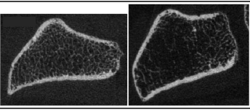
High Resolution peripheral QCT (HR-pQCT) quantitatively characterizes cortical and trabecular bone microstructure
Notes:
HR-pQCT is a 3D imaging technique that provides a 3D assessment of BMD but also quantitatively characterizes cortical and trabecular bone microstructure, a characterization that was previously possible only by bone biopsy47. Patients with identical BMD by DXA may have different risks for fracture, because DXA does not assess structural indices important for bone strength.
Bone density and microstructural and mechanical properties measured by HR-pQCT of the distal radius and tibia reflect the mechanical competence of the central skeleton

Slide 15
Aims 1 and 2
To define the longitudinal effect of HCV infection on changes in areal BMD (aBMD) measured by DXA in HIV+ women
To determine the relative contribution of HCV-related factors on aBMD in HIV+ women

Slide 16
Aims 1 and 2
Hypothesis 1: Compared with HIV-monoinfected and control women, HIV/HCV-coinfected women will have lower aBMD with greater longitudinal declines in aBMD.
Hypothesis 2: The association of HIV/HCV coinfection with aBMD will be mediated by inflammation, disorders of glucose metabolism, and severity of HCV-related liver fibrosis
  Higher levels of inflammation, impaired glucose metabolism, and more severe fibrosis will have lower aBMD

Slide 17
Women’s Interagency HIV Cohort Study (WIHS) Metabolic Study (MS): Methods
From 2003-2006, women from the WIHS Bronx, San Francisco and Chicago sites were enrolled in the WIHS MS with baseline, 2 and 5 year visits.
440 women (318 HIV+, 102 HCV+; 122 HIV-, 18 HCV+)
Rigorous metabolic testing including oral GTT and DXA to quantify BMD and regional fat were performed on all participants.

Slide 18
WIHS MS: Methods
Secondary analysis of 5-year longitudinal data from WIHS MS
Outcome variables: aBMD at the lumbar spine, femoral neck, and total hip measured by DXA
Primary predictor variable: HCV infection confirmed by HCVRNA
Analysis: Multivariate Linear Regression

Slide 19
WIHS MS: Methods
Covariates:
  Demographic and behavioral variables (e.g. age, race, smoking)
  Menopausal status
  Anthropometric measures: weight, BMI, waist circumference, waist to hip ratio
  HOMA-IR
  25-OH vitamin D level
  HIV and HCV-related factors
  Indirect markers of liver fibrosis (APRI and FIB-4)
  Inflammatory markers (TNF-a, IL-6, RANKL, osteoprotegerin)
  Bone turnover markers (Osteocalcin, C-telopeptide)

Slide 20
Table 1. Baseline Demographic and Clinical Characteristics of HIV-infected and Control Participants
Parameter | Controls (n = 105) | HIV+ (n = 215) | HIV+/HCV+ (n = 102)
Age (y) | 36 (30-41) | 41 (36-47) | 47 (43-51)
Race
African-American | 59 (56.2%) | 121 (56.3%) | 64 (62.8%)
Hispanic | 19 (17.1%) | 23 (10.7%) | 6 (5.9%)
Caucasian | 12 (11.4%) | 29 (13.5%) | 12 (11.8%)
Other | 16 (15.2%) | 42 (19.5%) | 20 (19.6%)
Menopause | 1 (1%) | 43 (20%) | 46 (45.1%)
Current tobacco use | 64 (61%) | 112 (52.3%) | 76 (76%)
Current alcohol use | 66 (62.9%) | 107 (49.5%) | 44 (42.6%)
Current opiate use | 11 (10.5%) | 17 (7.9%) | 33 (32.4%)
Diabetes | 15 (14.3%) | 42 (19.5%) | 28 (27.5%)
BMI (kg/m²) | 29.9 (25.5-37.1) | 27.8 (24.1-32.1) | 25.2 (22.1-29.9)
Waist Circumference (cm) | 91.9 (81.7-103.3) | 89.7 (80.8-99.8) | 85.8 (78-96.1)
Current CD4 (cells/uL) | - | 416.5 (277.5-591) | 374 (227.5-600.5)

Slide 21
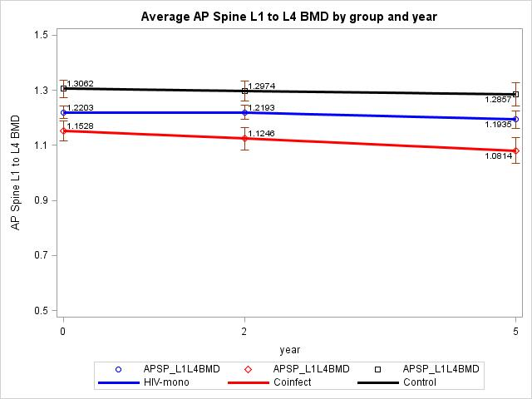
(g/cm²)

Slide 22
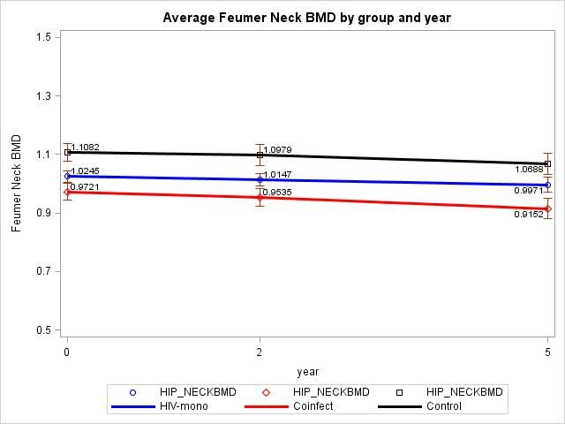
Average Femoral Neck BMD by group and year
Femoral Neck BMD (g/cm²)

Slide 23
Aim 3
To investigate the effects of HCV and its related factors on changes in vBMD measured by QCT and bone quality and microarchitecture measured by HR-pQCT in HIV+ women

Slide 24
Aim 3
Hypothesis 3a: Compared with HIV-monoinfected and control women, HIV/HCV-coinfected women will have greater decline in vBMD and worse parameters of bone quality.
Hypothesis 3b: The association of HIV/HCV coinfection with vBMD, bone quality and microarchitecture will be mediated by severity of HCV-related liver fibrosis.

Slide 25
WIHS Musculoskeletal Substudy (MSK): Methods
The WIHS MSK Substudy began enrollment in October 2011 and studies women from the same 3 sites as WIHS MS
WIHS MSK studies the effect of the menopausal transition on BMD and bone microarchitecture

Slide 26
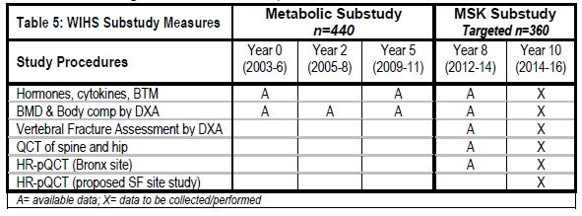
WIHS MSK: Methods

Slide 27
WIHS MSK: Methods
Secondary analysis of longitudinal vBMD data from WIHS MSK Study of targeted 360 HIV+ and HIV- women
HR-pQCT performed in a subgroup of 130 HIV+ and HIV- women (approximately 86 HIV+, 26 HIV/HCV+, 44 HIV-) at Bronx site
We will perform an ancillary study enrolling 30 additional HIV/HCV coinfected women from the SF WIHS MSK site

Slide 28
WIHS MSK: Methods
Outcome variables: vBMD at spine and hip measured by QCT; parameters of cortical and trabecular bone quality and microarchitecture measured by HR-pQCT
Primary predictor variable: HCV infection
Covariates: similar as in WIHS MS but including:
  Anti-mullerian hormone (AMH), an objective biomarker of ovarian reserve, to determine the perimenopausal transition.
  ELF score and TE to measure liver fibrosis severity
Analysis: Multivariate Linear Regression

Slide 29
Acknowledgments
Carl Grunfeld, MD PhD
Phyllis Tien, MD
Rebecca Scherzer, PhD
Dolores Shoback, MD
Anne Schafer, MD

Slide 30
Thank you!
Questions?

Slide 31
Future Directions
With the advent of new HCV direct-acting antiviral (DAA) regimens:
To determine the effects of HCV clearance on changes in BMD, bone quality and microarchitecture in HIV/HCV-coinfected women
To determine the effects of persisting liver fibrosis on parameters of BMD, quality and structure

