Slide 1
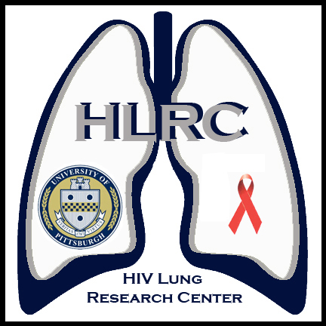
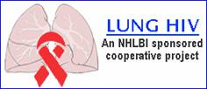

Lung disease in HIV: An unrecognized co-morbidity
Alison Morris, MD, MS
Associate Professor of Medicine, Clinical & Translational Science, & Immunology
Division of Pulmonary, Allergy, & Critical Care Medicine
University of Pittsburgh

Slide 2

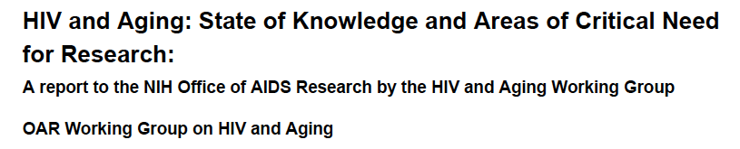

Slide 3
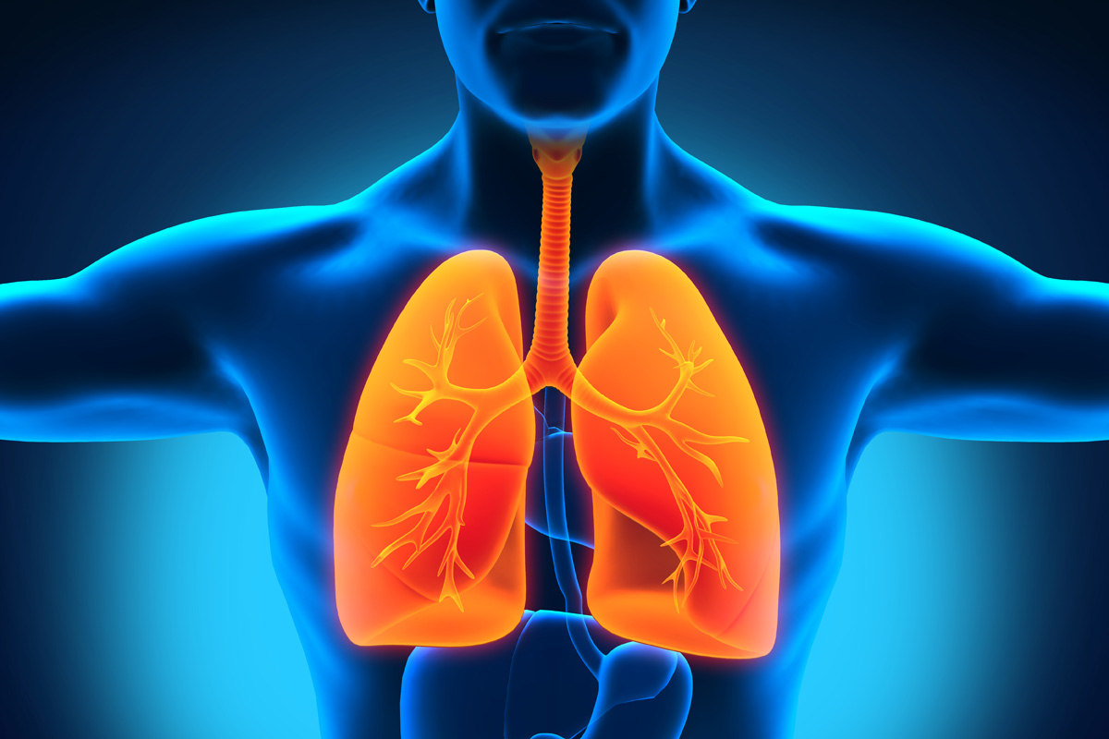
?

Slide 4
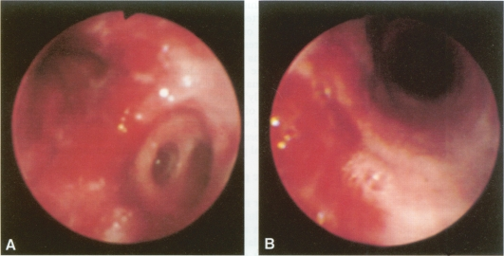
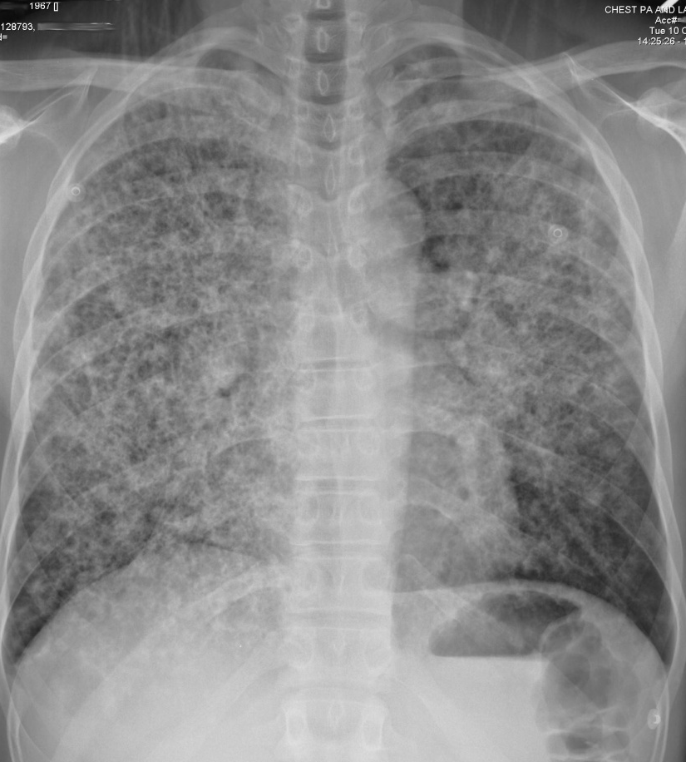
Lung disease leading cause of mortality in early HIV epidemic
Infections:
Pneumocystis pneumonia
Tuberculosis
Bacterial pneumonia
Neoplasms:
Kaposi sarcoma
Lymphoma

Slide 5
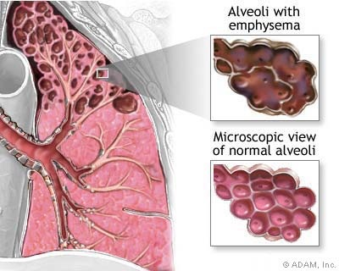
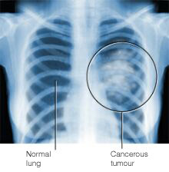
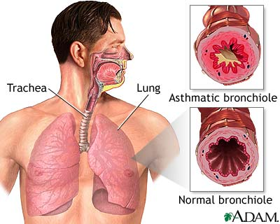
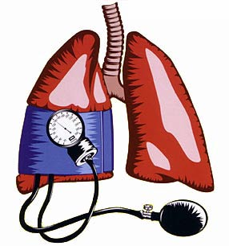
Other lung complications reported more frequently
COPD
Lung cancer
Pulmonary arterial hypertension
Asthma

Slide 6
Lung disease likely HANA
Large surface area with constant exposure to environment
Infections
Toxins/smoking
Lung is vulnerable to systemic inflammation
Immune activation
Microbial translocation
Many lung diseases associated with aging

Slide 7
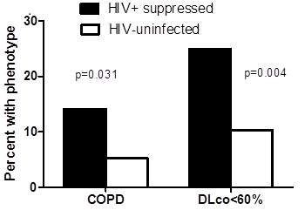
Pulmonary abnormalities remain common despite successful ART
Morris, unpublished data

Slide 8
6-minute walk distance significantly less in HIV+ individuals with cardiopulmonary impairment
Morris, unpublished data

Slide 9
HIV+ individuals who died had significantly worse cardiopulmonary function adjusted for age, pack-year smoking, and CD4 cell count
Morris, unpublished data

Slide 10
Mechanisms may be similar to other end-organs
HIV
Immune activation/inflammation
Microbiome/colonization/translocation
ART
Aging
Oxidative stress
Endothelial cell dysfunction

Slide 11
HIV and COPD

Slide 12
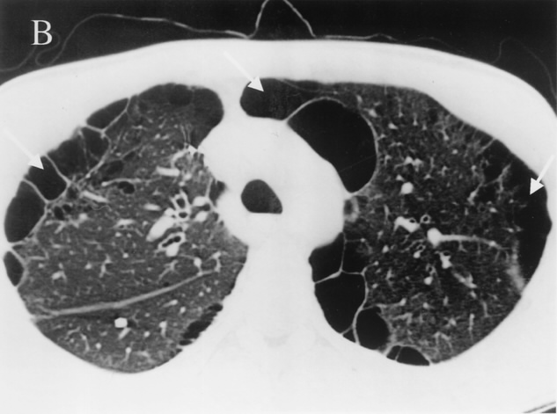
COPD and HIV: Pre-ART: Increased prevalence even in those without AIDS, primarily emphysema
Kuhlman et al. Radiology 1989;173:23-6
Diaz et al. Ann Int Med 2000;132:369-72
Diaz et al. Chest 2003;123:1977-82

Slide 13
Is COPD increased in the ART era and why?

Slide 14
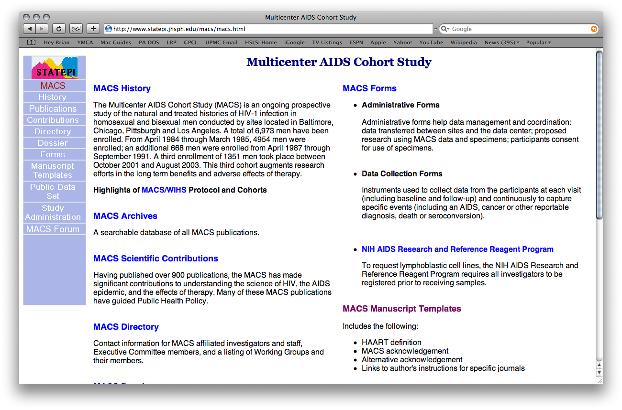
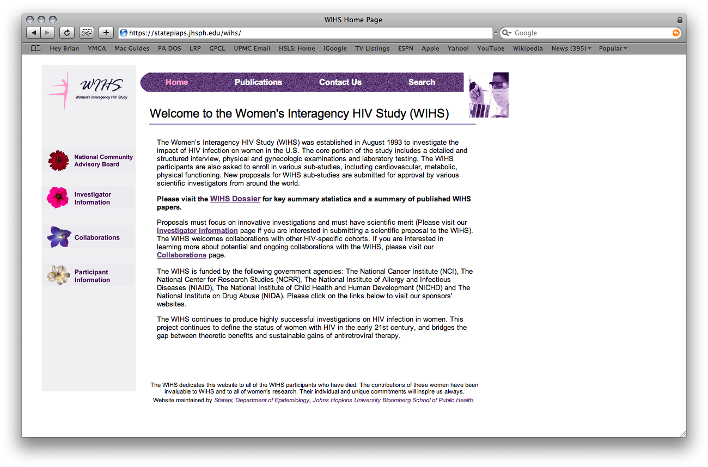
Multicenter AIDS Cohort Study (MACS)
Women’s Interagency HIV Study (WIHS)
Pittsburgh Clinical Trials Unit
Notes:
Outpatients, generally healthy, young, average age in 40s

Slide 15
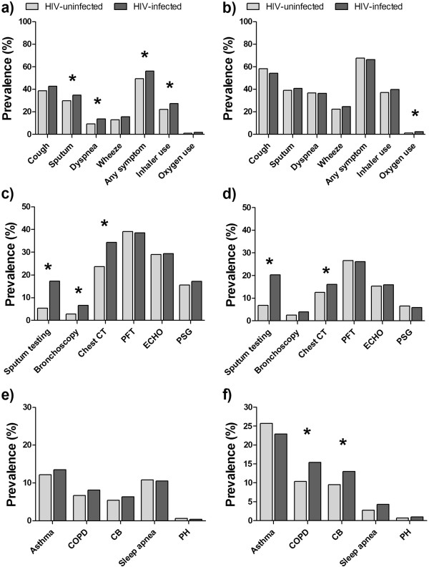
MACS
WIHS
Gingo MR, Balasubramani GK, Kingsley L, Rinaldo CR, et al. (2013) The Impact of HAART on the Respiratory Complications of HIV Infection: Longitudinal Trends in the MACS and WIHS Cohorts. PLoS ONE 8(3): e58812. doi:10.1371/journal.pone.0058812

Slide 16
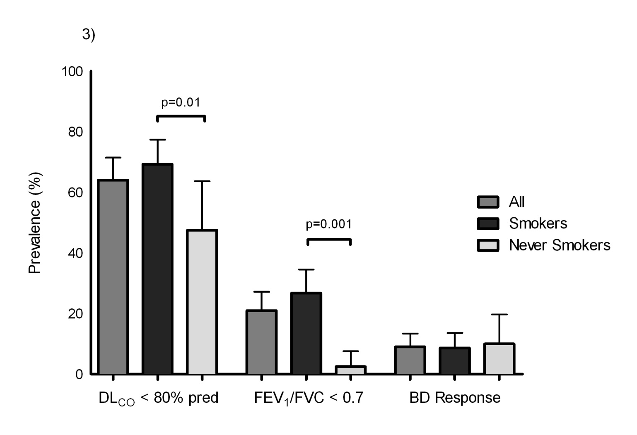
Abnormal diffusing capacity VERY common, even in non-smokers
Obstruction more common in smokers
Gingo et al. AJRCCM 2010

Slide 17
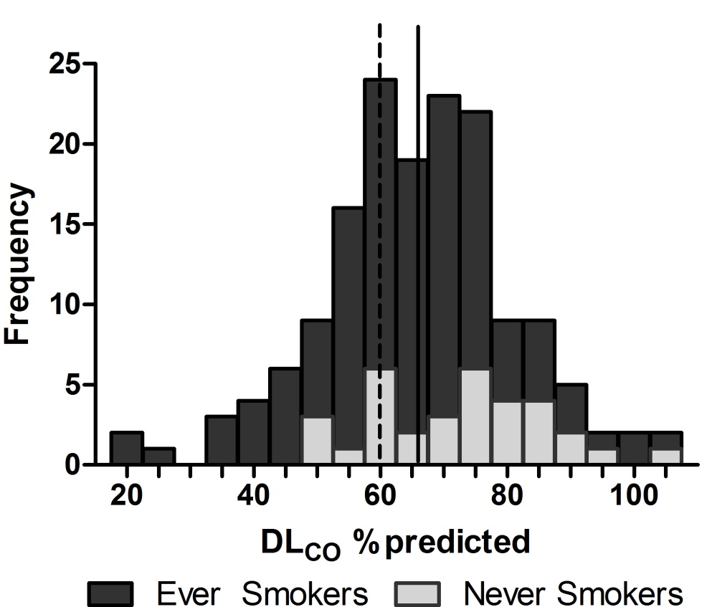
DLco is abnormal in majority of HIV+ individuals
-85% of cohort have DLco<80% predicted
-35% are below 60% predicted
-24% of never smokers are below 60% predicted
Gingo M et al, Eur Resp J, 2014

Slide 18
Diffusing capacity
Measures multiple aspects of lung and cardiac function
Noted to be low in HIV in pre-ART era
Until recently, not much known about in current era
Emerging as important phenotype in HIV

Slide 19
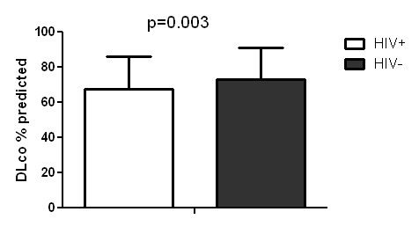
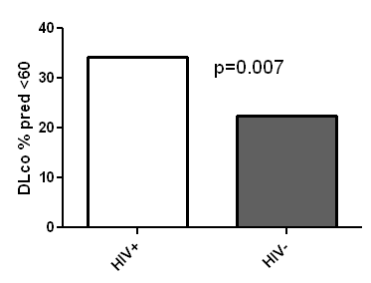
DLco lower in HIV+ women and more have moderately reduced DLco (<60%)
Fitzpatrick M, Gingo M et al, JAIDS, 2013

Slide 20
Peripheral inflammation associated with low DLco
DLco
CRP
IL-6
sCD163
D-dimer
Fitzpatrick M et al, in revision

Slide 21
Mechanisms may be similar to other end-organs
HIV
Immune activation/inflammation
Microbiome/colonization/translocation
ART
Aging
Oxidative stress
Endothelial cell dysfunction

Slide 22
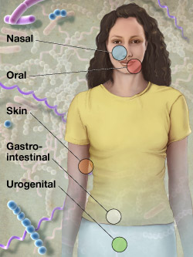
The Human Microbiome Project
-Microbial cells outnumber human cells 10:1, greater genetic diversity
-99% of bacteria not currently culturable
-Use high-throughput sequencing to determine species of bacteria
-Insights into obesity, GI disease, dental disease, skin

Slide 23


Lung microbiome in HIV
Normal lung microbiome resembles bacteria in mouth, increases in bacteria like Haemophilus
In a few individuals, detected Trophyrema whipplei
Morris A, Am J Resp Crit Care, in press

Slide 24
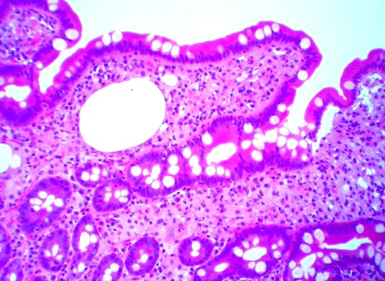
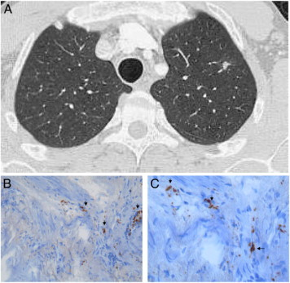
Agent of Whipple’s disease, lung involvement rare
Urbanski G, Chest, 2012

Slide 25
T. whipplei found at increased levels in HIV+
p<0.001
Luzopone C, Am J Resp Crit Care Med, in press

Slide 26
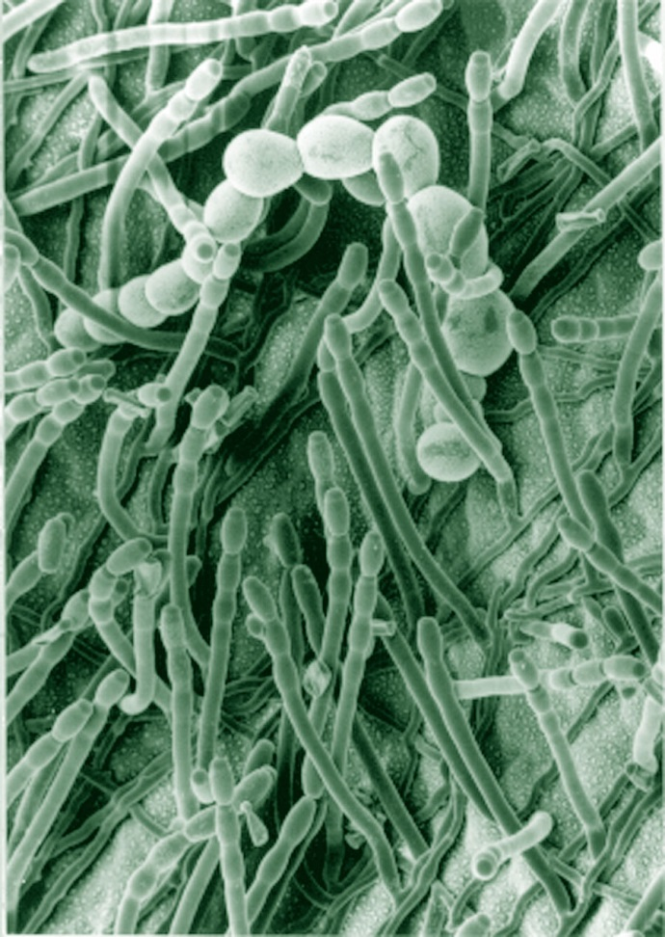
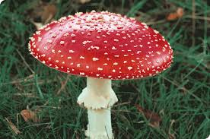
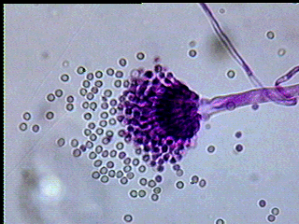
What about fungus (mycobiome)?

Slide 27
Why is the mycobiome important?
Ubiquitous in environment
1.5-5 million species, only 5% classified, many cannot be cultured
Increasing invasive fungal infections
Increasing use of antibiotics may promote fungal overgrowth

Slide 28
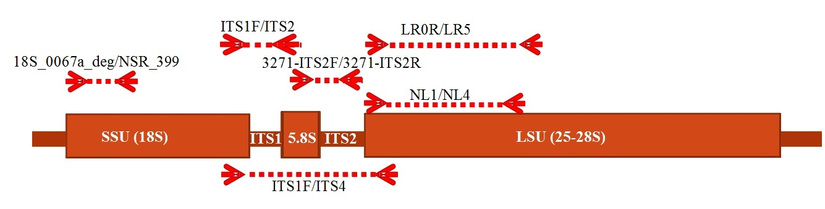
Mycobiome analysis
Signature: fungal rDNA (ITS, 18S)
ITS more diverse, better genus-level discrimination, different regions
18S better amplification
Results can be very different
Cui L, et al. Genome Medicine, 2013
Notes:
1 Most microbiome studies are about bacterial microbiome; 2 No study in the scale of microbiome has been done before.

Slide 29
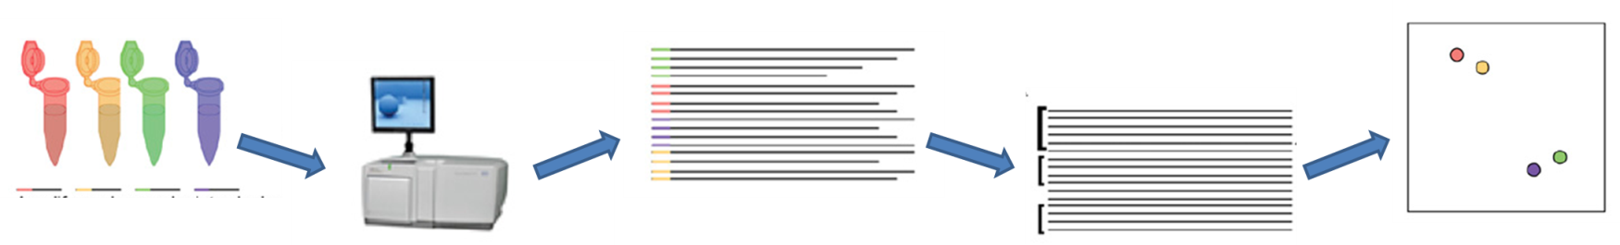
Lung HIV Mycobiome Study
56 HIV+ and HIV- individuals from Lung HIV Microbiome Program
Oral wash (OW), induced sputum (IS) and bronchoalveolar lavage (BAL), environmental controls
Analyzed by sample type, HIV status, and lung function
Courtesy of L. Cui
Notes:
Two different impairments likely present two different phenotypes of lung disease. DLco: Diffusing capacity of carbon monoxide

Slide 30
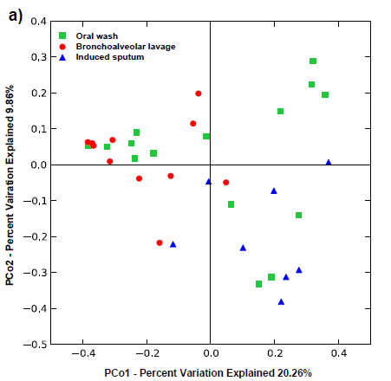
BAL, sputum, and oral wash differ in non-HIV

Slide 31
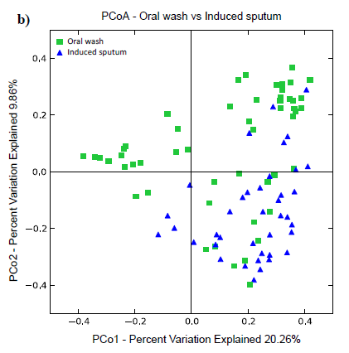
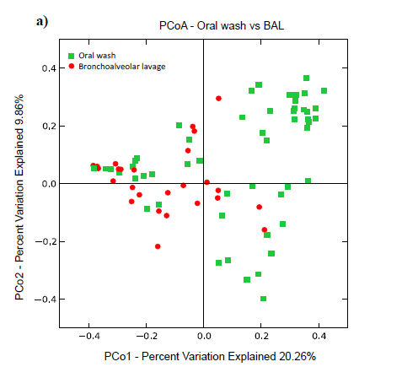
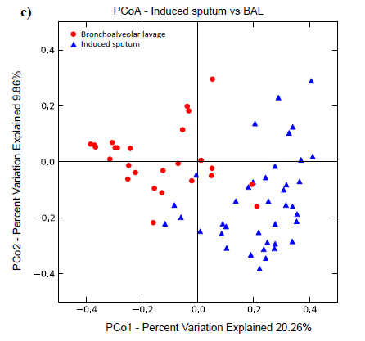
Oral wash, sputum, and BAL are separate in overall cohort

Slide 32
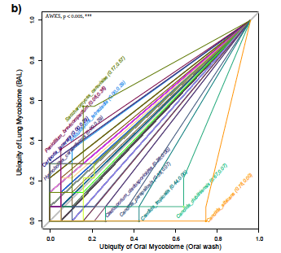
Lung differs from oral in non-HIV
Saccharomyces
Candida

Slide 33
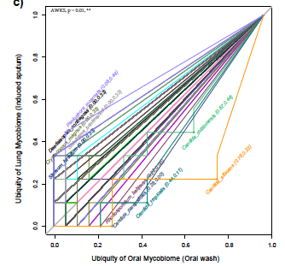
Induced sputum differs from oral wash
Crypto
Candida

Slide 34
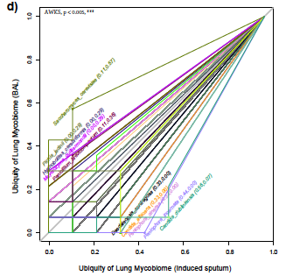
Induced sputum and BAL differ
Saccharomyces

Slide 35
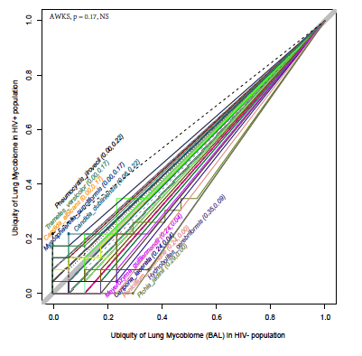
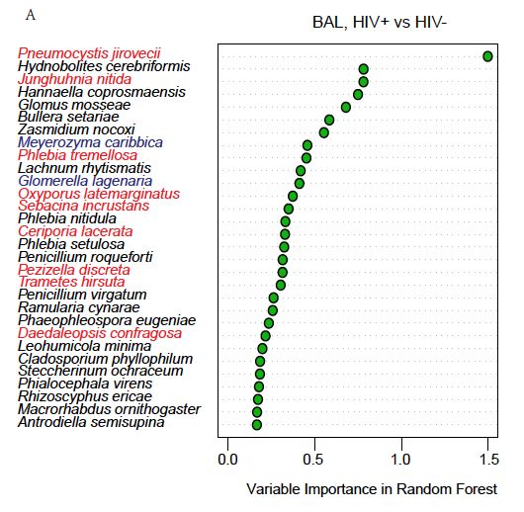
HIV+ and HIV- differ in communities

Slide 36
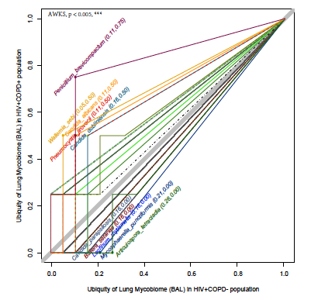
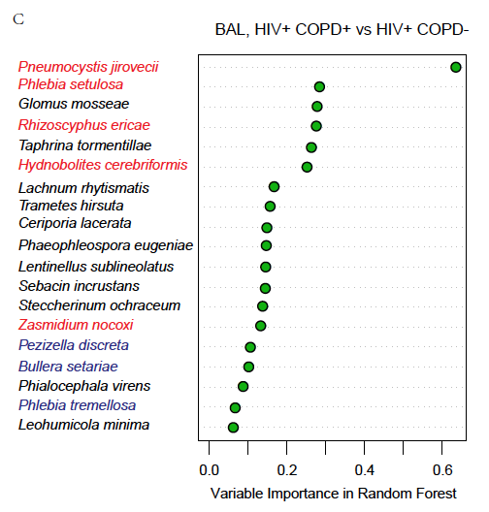
COPD differs in HIV: Primarily Pneumocystis

Slide 37
HIV and COPD conclusions
COPD remains increased in HIV in the current era
Obstruction common, but diffusing capacity most common abnormality even in non-smokers
Likely multifactorial
Possible role of Pneumocystis colonization or other pathogens

Slide 38
Standard treatments not tested in this population
Difficulties with inhaled steroids
Oral candidiasis
Increased bacterial pneumonia and tuberculosis
Interactions with other drugs, high serum levels
Notes:
Now starting to understand epidemiology

Slide 39

Summary: Tip of the iceberg?
-Lung disease in HIV remains an important problem
-Chronic lung diseases such as COPD, asthma, and PAH may become more important
-Mechanisms not understood
-Aging population, continued smoking, effects of HAART, difficulties with treatment

Slide 40
WIHS Lung Projects
RO1 Translational evaluation of aging and lung disease
U01 Pathogenesis of obstructive lung disease
R01 Prevalence and pathogenesis of lung disease in HIV infection
R34 Statins for pulmonary and cardiac complications of HIV
R01 Longitudinal evaluation of aging and effects on lungs

Slide 41

Acknowledgments
Matt Gingo
Meghan Fitzpatrick
Patty George
Robert Hoffman
Danielle Camp
Andrew Clarke
Vishal Keshari
Cathy Kessinger
Nic Leo
Lorrie Lucht
John Ries
Shulin Qin

Slide 42
Acknowledgments
Univ. of Pittsburgh
-Dawn Weinmann
-Deb McMahon
-Larry Kingsley
--J. Ken Leader
-Lijia Cui
-Adam Fitch
-Elodie Ghedin
-Eustace Fernandes
-Heather Kling
-Karen Norris
-Rebecca Tarentelli
-Frank Sciurba
-Tim Shipley
University of California, San Francisco
Ruth Greenblatt
Jennifer Cohen
Audrey Ondrade
Nancy Hessol
Claudia Ponath
Laurence Huang
Serena Fong
Stephen Stone
University of California, Los Angeles
Eric Kleerup
John Dermand

