Slide 1
The Early Days of an Investigator in WIHS: Grants and Projects
By
Bani Tamraz, Pharm.D., Ph.D.
Associate Clinical Professor
School of Pharmacy

Slide 2

Research Interests
Identification of genetic determinants of drug response
Translate to new diagnostics and treatment strategies

Slide 3
Why WIHS
Mentoring
Pharmacology
A content placeholder. Use for text, graphics, tables and graphs. You can change this text or delete it.
  Here is a placeholder for more text. You may delete this text
  Here is a placeholder for more text. You may delete this text
Rich Data Set
Hair and iPK
Notes:
Rich data set: Represents conditions of actual use, treatment related phenotype data and speciments that can be accessed.
Hair and iPK data on ARV: AUC is the best predictor of treatment response

Slide 4
Grants and Projects
CFAR Supplement
  Title: GWAS of darunavir in two biomatrices from women in HIV
Translational Scholar Career Awards in PG and Personalized Medicine (K23)
    Project development stage

Slide 5
Background
HAART does not work for everyone.
  20-40% failure
Failure can be due to various factors
  Poor adherence, drug resistance, suboptimal regimen potency
Understanding the contribution of various factors that influence drug exposure can improve treatment response
Notes:
Despite its effectiveness, many patients experience virologic failure during highly active antiretroviral therapy (HAART), as evidenced by viremia during treatment.

Slide 6
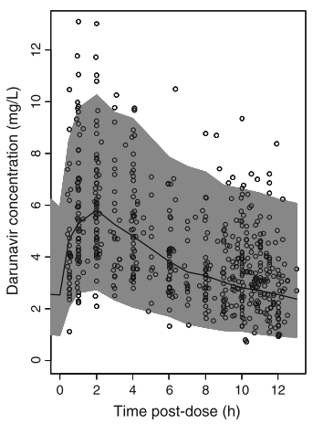
CFAR Supplement: Background and Goal
Variability in drug exposure is common
  Can contribute to clinically important outcome
Genetic variability combined with other characteristics can predict drug exposure
Hair is a novel matrix that enables better measurement of exposure
Model interindividual variability in exposure to darunavir in women
Lead to precise, safe and effective treatment
Moltó et al. Clin PK, 2013
Notes:
Darunavir is extensively metabolized by CYP3A4 at the liver and at the intestine. PK is inhanced by administering with with Ritonivir.
PK analysis was performed with 705 plasma samples from 75 caucasian individuals (64 male) receiving darunavir/ritonivir for at least 4 weeks.
Darunavir CL was 12% lower in pts with SLC03A1 rs8027174 GT/TT genotype, while HZ for rs4294800 A allele was associated with 2.5 fold higher central volume of distribution. 15 candidate genes were genotyped (All transporters)

Slide 7
CFAR Supplement: Aims
  Conduct a genome-wide association study of darunavir exposure measured in intensive pharmacokinetic (iPK) study using a pilot sample of HIV positive women (n=120) under conditions of routine use.
  Validate genetic associations discovered in Aim 1 in an independent cohort of HIV-infected women (n=512) under conditions of routine use using a novel biomatrix of darunavir exposure, (i.e., hair).
Notes:
The desired model would incorporate patient characteristics and PG data contributing to variability in drug concentrations and also take into account the interaction between the two compounds.

Slide 8
CFAR Supplement: Approach
WIHS population who used darunavir for at least 6 months prior to PK evaluation
Darunavir iPK data set – Short Term Exposure
  N = 120
Darunavir Hair Concentrations – Long term exposure
  N = 512
WIHS GWAS Data Set
  Illumina Omni2.5 SNP Array : 5,000,000 SNPs

Slide 9
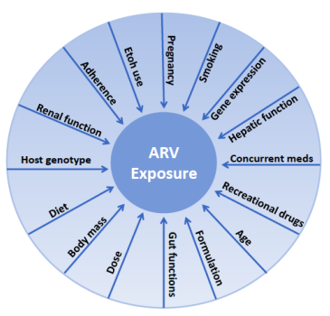
CFAR: Analysis Plan
The drug exposure both in hair and plasma will be analyzed in relation to a number of non-genetic factors that can influence darunavir exposure
Assess the association between genotype and drug exposure
  SNP data will be added to multivariate models that include non-genetic factors.
Genetic associations identified in the iPK Discovery Cohort (aim 1) and confirmed in the Hair Biomatrix Validation Cohort (aim 2) will also be tested for their association with clinically relevant responses to darunavir therapy (i.e., undetectable viral load at 6 months, duration of virologic suppression, CD4 T-cell count>350 at 1 year).
Non-genetic factors influencing variability
Notes:
The drug exposure both in hair and plasma will be analyzed in relation to a number of non-genetic factors (e.g., race/ethnicity) that influence darunavir exposure (Figure 2). To assess the association between genotype and drug exposure, SNP data will be added to multivariate models that include non-genetic factors. Genetic associations identified in the iPK Discovery Cohort (aim 1) and confirmed in the Hair Biomatrix Validation Cohort (aim 2) will also be tested for their association with clinically relevant responses to darunavir therapy (i.e., undetectable viral load at 6 months, duration of virologic suppression, CD4 T-cell count>350 at 1 year).

Slide 10
Translational Scholar Career Awards in PG and Personalize Medicine (K23)

Slide 11


My most genuine interest is early studies to APPLY pharmacogenetics data
Notes:
This is an area of interest of mine

Slide 12






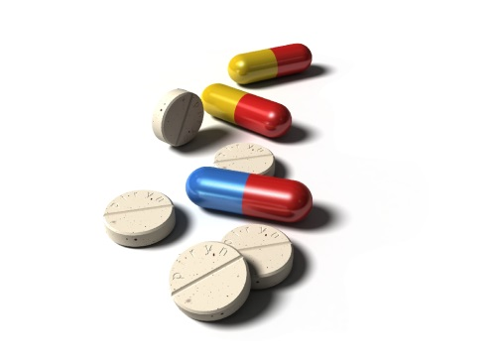
WIHS Data
Clinical Data
PERFECTION
Medications
Genotypes
Notes:
Develop algorithms capable of predicting drug-gene interactions

Slide 13
Medications
ARV
Othermeds
Antibiotics
Notes:
Develop algorithms capable of predicting drug-gene interactions
Select population of patients who are high risk for receiving a drug with an actionable pharmacogenetic story that is in our database.
Develop informatics tools to provide point of care service. Track outcomes
Establish a drug-gene interaction database
Comprehensive, curated, up to date
Develop algorithms capable of predicting drug-gene interactions
Design customized gene chip array
Testing the DNA chip assays and predictive algorithm in preselected individuals
Set up necessary sample processing protocols
Establish FuturoGen’s drug-gene interaction database, 2) Design customized gene chip, 3) Develop algorithm capable of predicting individual risks for adverse drug reaction based on the DNA variants present in them. 4) Creating endpoint user-friendly software and interface,
Developing algorithms that could make heuristic predictions for individual risk to adverse drug reactions for subjects with rare variants not yet catalogued as pharmacogenetically important

Slide 14
Early challenges: “other meds”
Spelling errors
  Ex: Abilify: Ability, Abilizy, Abinafy
  Ex: Simvastatin: Simuastatin, Simvastin, Zorcor
  Ex: Leovthyroxine:
Missing information
  “Cholesterol med”, “sleep med”, “Itching pill”
Misclassification
  Abilify: codes 548 (Other antipsychotics) and 555 (Alzheimer med)
  Simvastatin: 808 (pravastatin) and 809 (simvastatin)
  MedCode 4035 (Lopressor, Toprol, Metoprolol): “Loprimede”

Slide 15
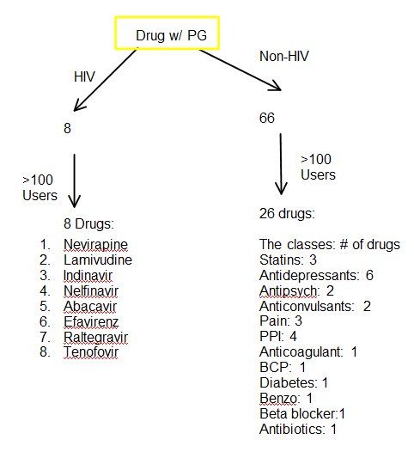

Slide 16
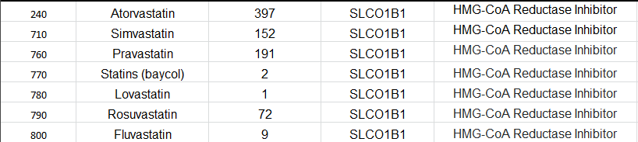

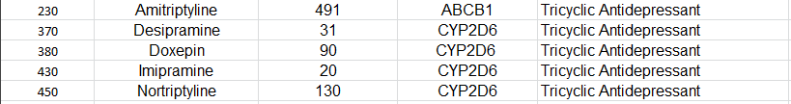
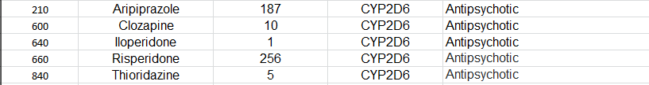

Slide 17


Slide 18
Why WIHS?
Strong commitment to pharmacology research
Strong commitment to mentoring new investigators
  Amazing mentors and support
Rich data set
  Represents conditions of actual use
Hair and iPK data on ARV
  AUC is the best predictor of treatment response
Completed GWAS
  Resource efficient

